Slide 1




Rawdah System for Nursery Management
A comprehensive and integrated system designed to manage all nursery departments for successful administration. It is tailored for staff, parents, and students.
Powered by

Slide 2
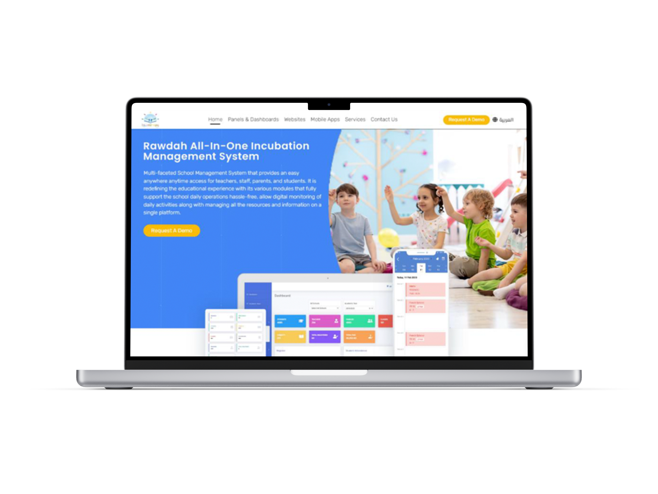


Key Features of the Rawdah Platform
Rawdah:
Rawdah is a specialized system for managing nurseries, educational processes, and e-learning in early childhood institutions. It also facilitates communication between parents and teachers through the nursery’s dedicated website or mobile application.
The system enables seamless delivery of educational content, class schedules, and exam timetables for different learning stages, keeping parents and students continuously informed. It also supports the admission process for new students as well as tuition fee payments for the academic year.
The platform is available in both English and Arabic, and can be accessed via the web and mobile devices.

Slide 3












System Modules
Enrollment
Timetables
Nursery Grades
Entitlements
Announcements
Complaints
Audit Log
Attendance
Nursery Payments (Installments)
General Settings
Notifications
Printable Documents
Users & Permissions
Homework Sheets
Interactive Online Lessons via Microsoft Teams
Online store

Slide 4

System Users
Department Heads
Admission & Registration Officers
Parents
System Administrators
Students
Accountants
Social Workers
Teachers

Slide 5
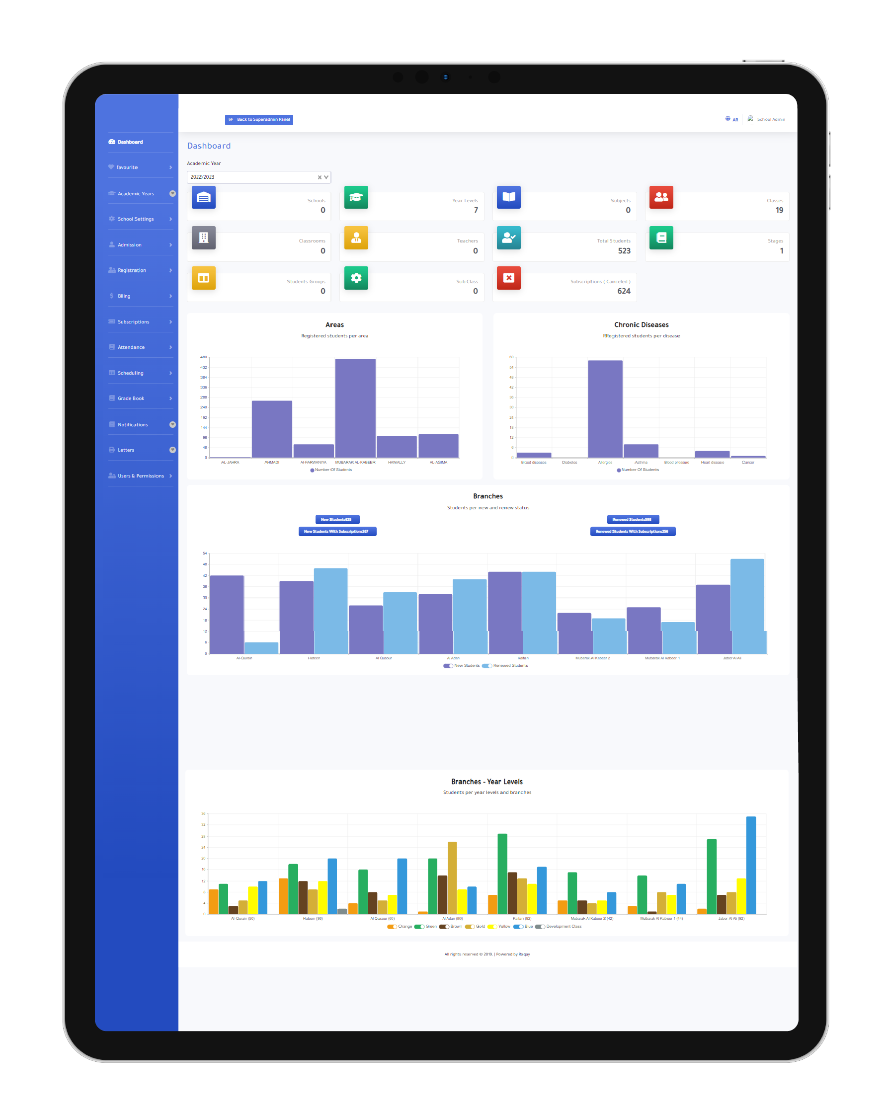

Dashboard (System Features)
Homepage:
Consists of a set of statistics providing a complete overview of the nursery.

Slide 6
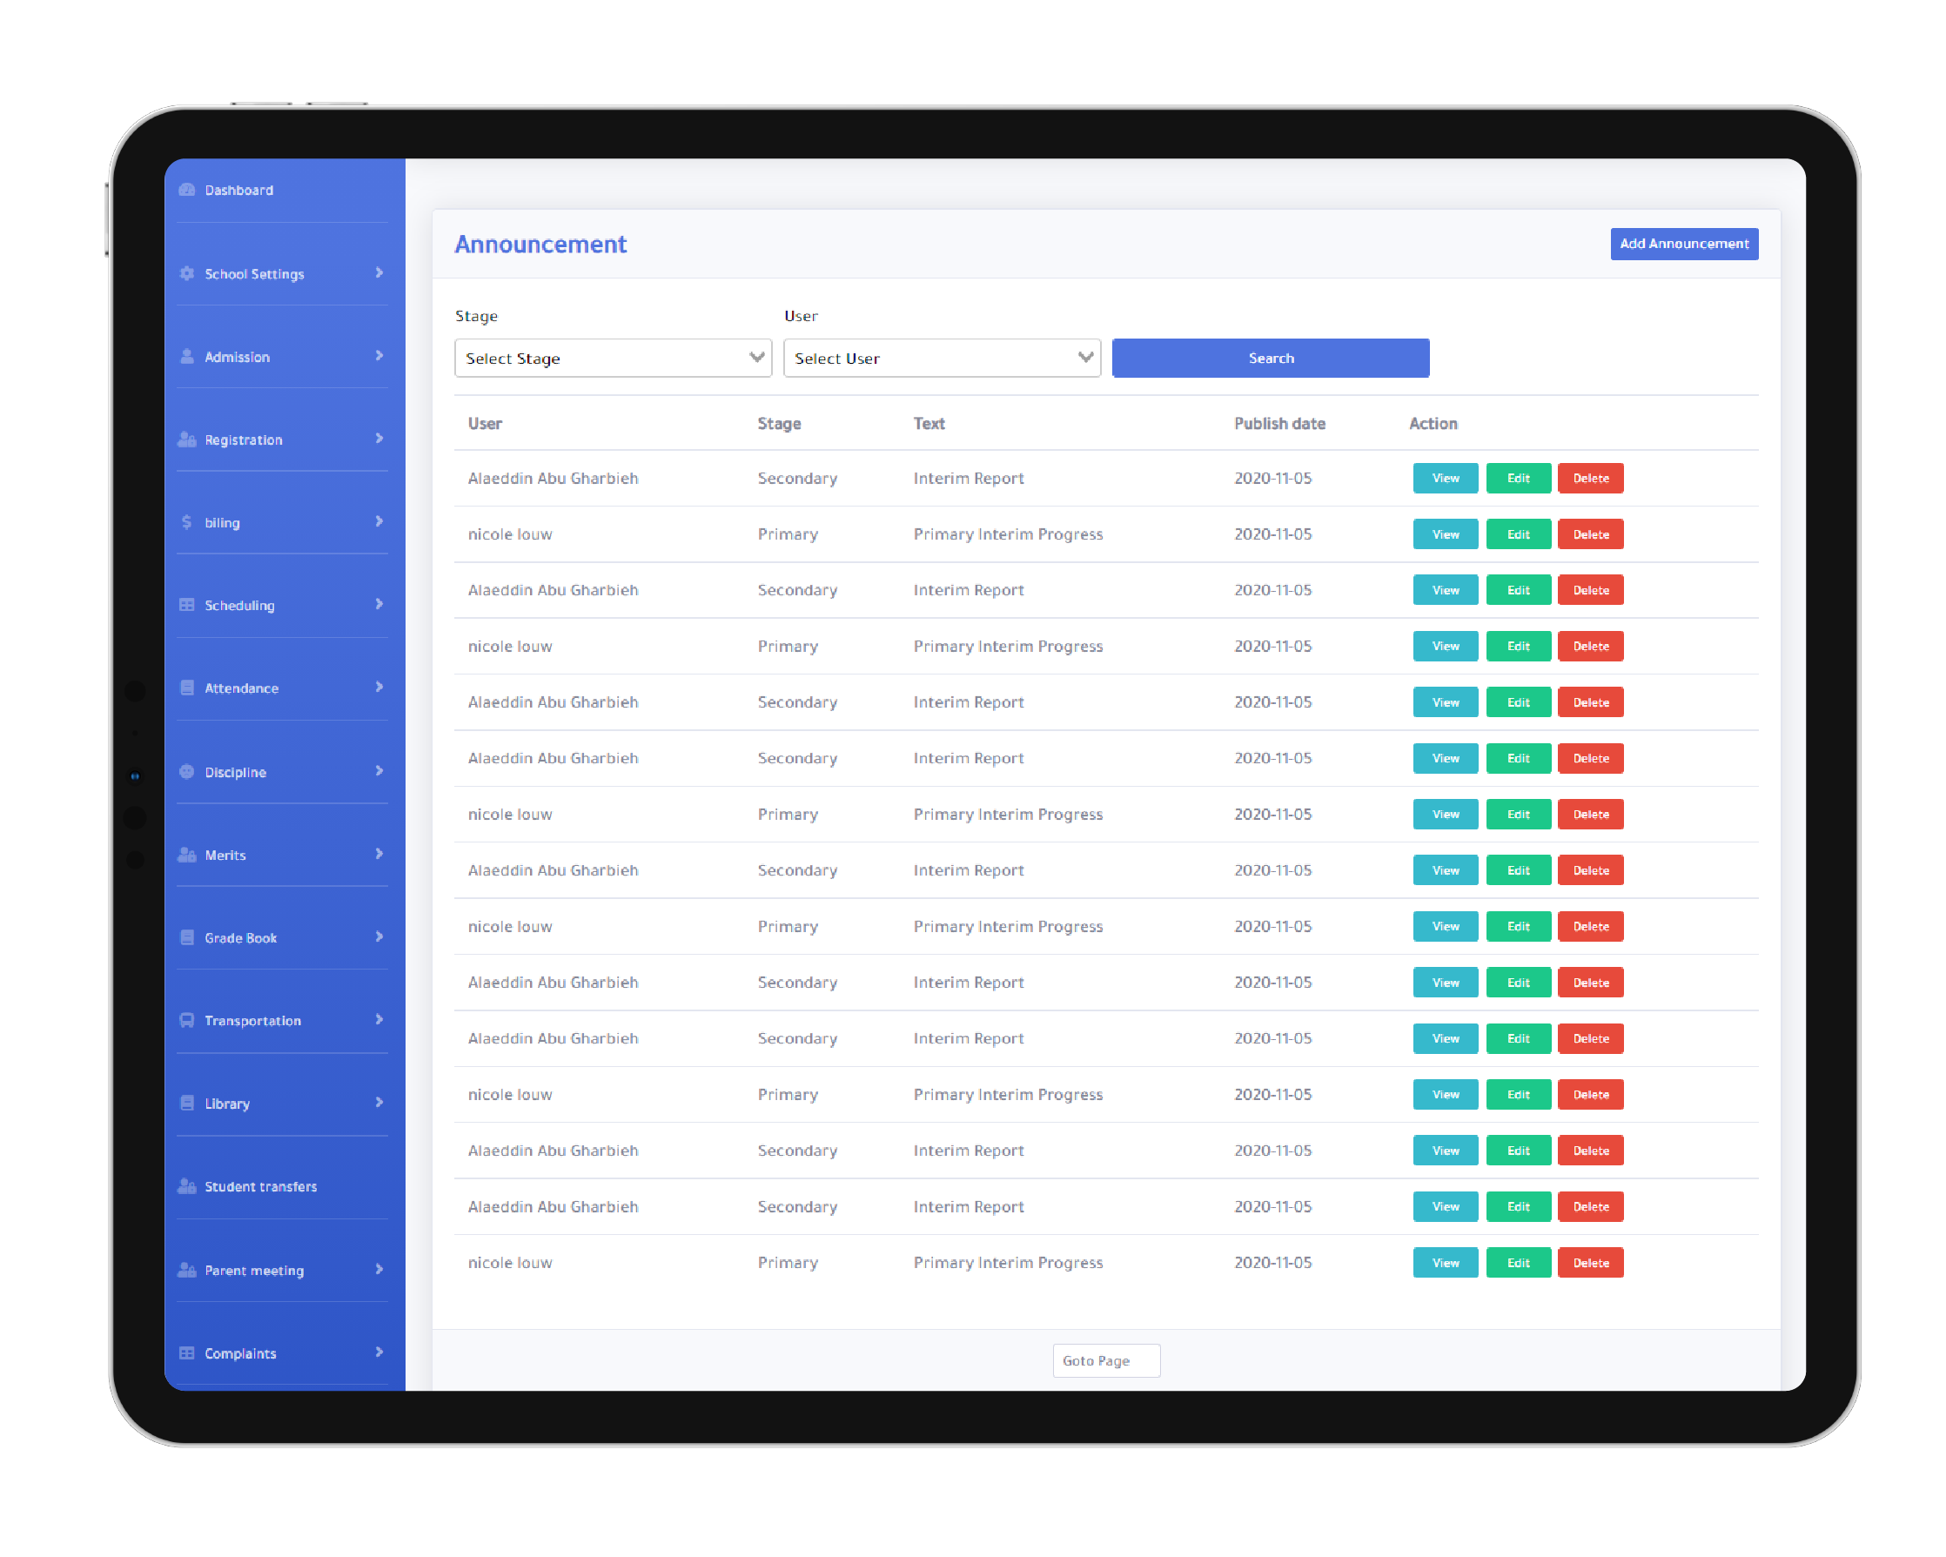
General Settings
A bilingual control panel (Arabic & English) with a responsive design accessible from any computer, laptop, tablet, or mobile phone.
Includes a set of nursery-related settings required to enable full system operation.
The system administrator can add, update, or delete the nursery’s general data.
The system administrator can also add users and assign permissions for each user.
The system provides financial reports as well as admission and registration reports.
It also displays key statistics related to the entire system.

Slide 7
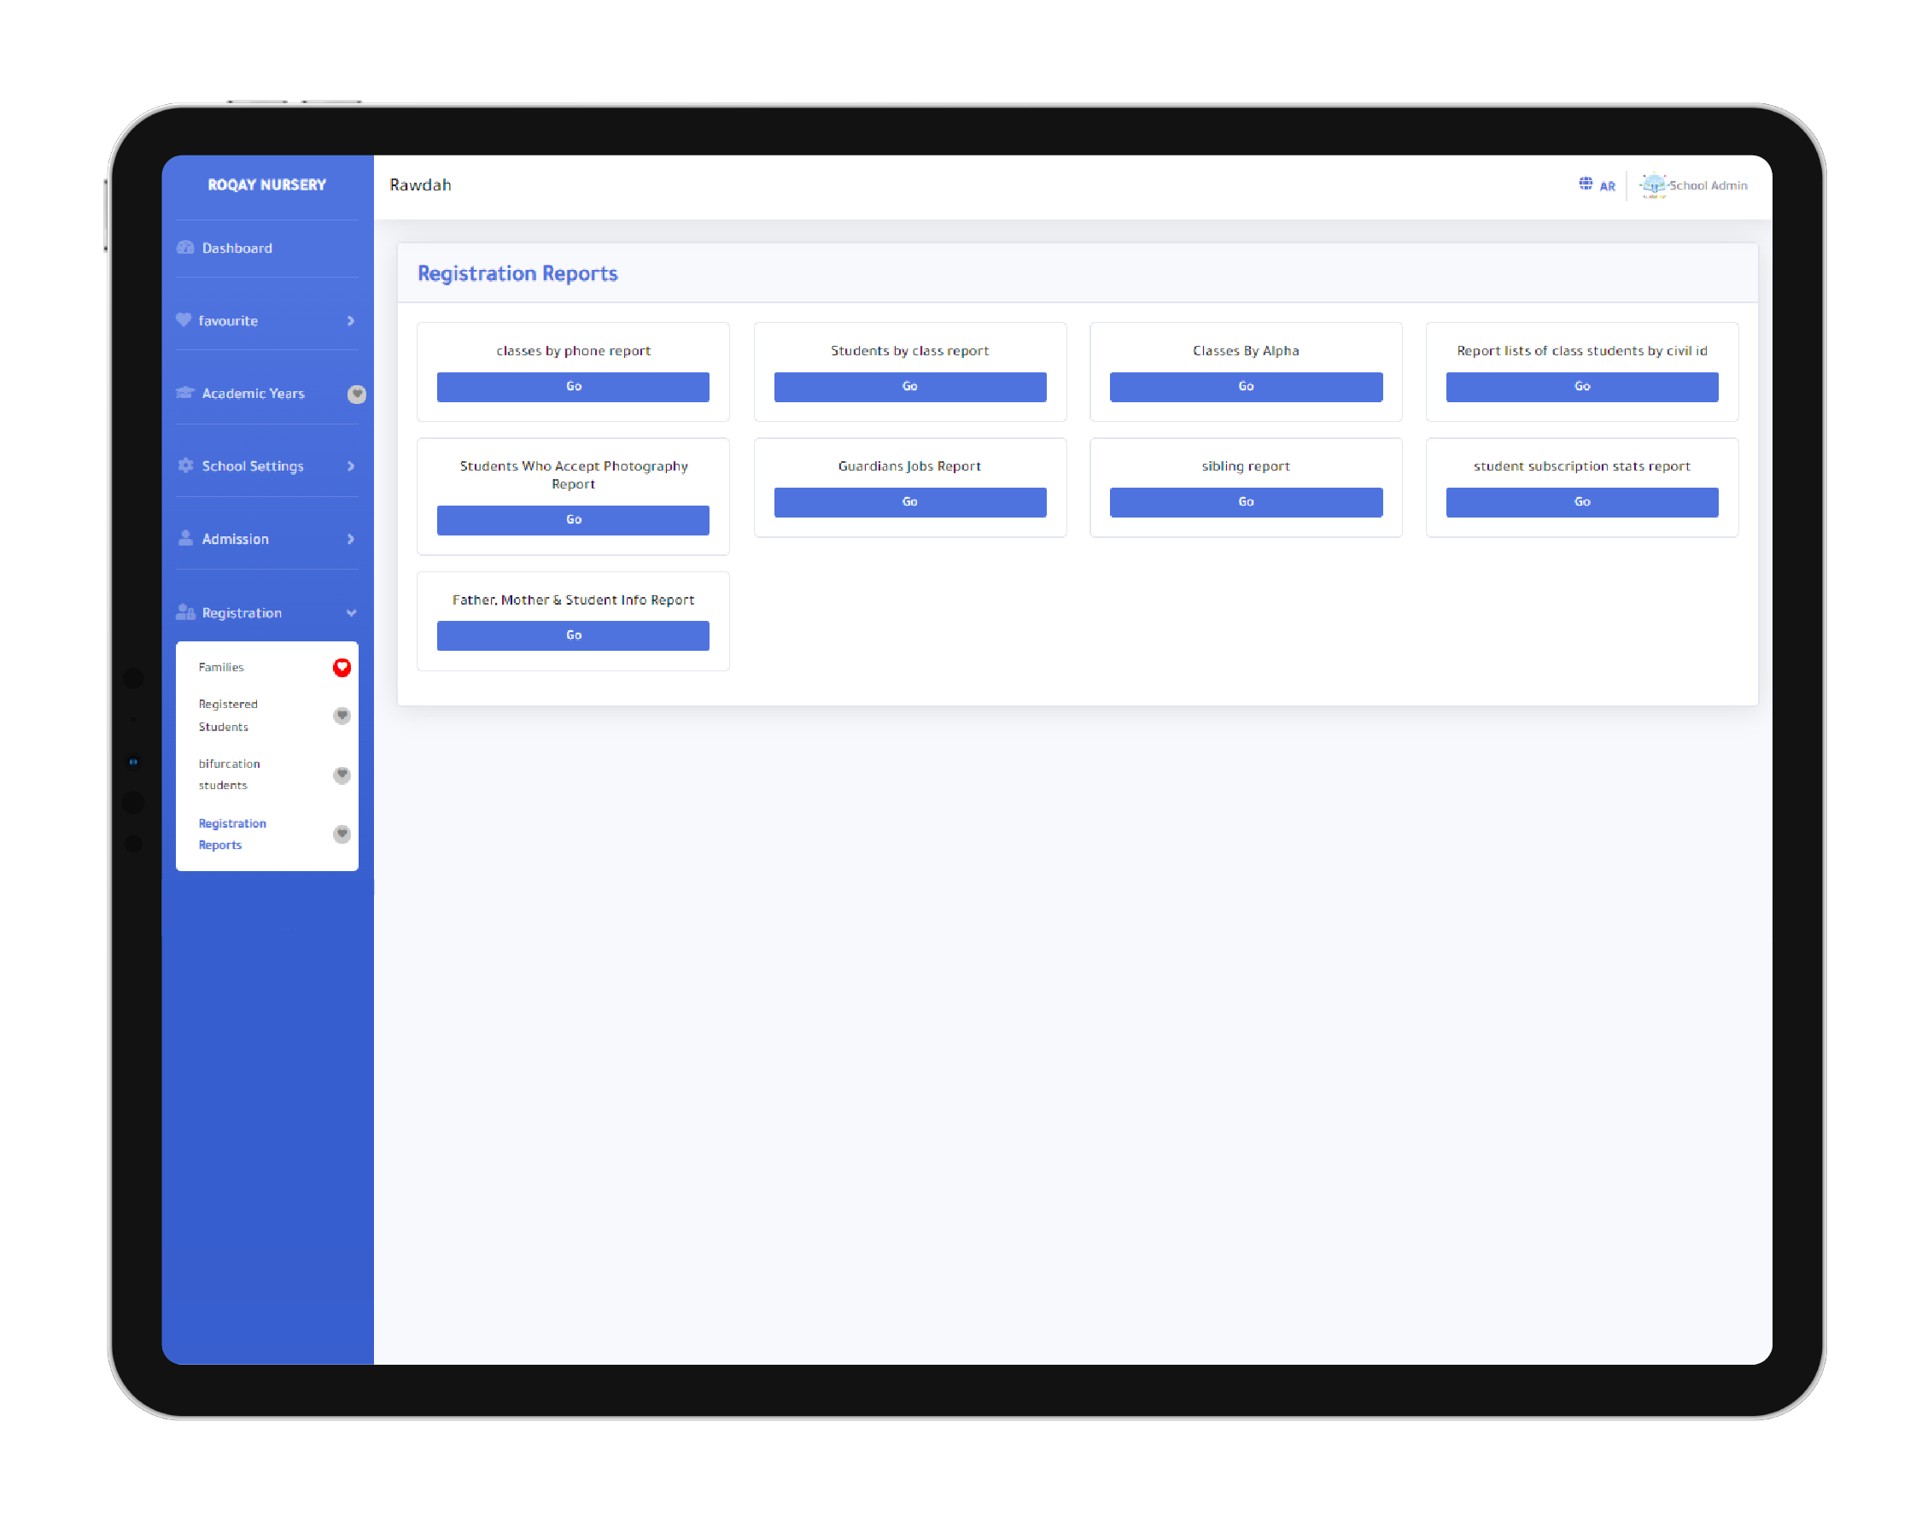
Enrollment
During the enrollment stage, the registration officer enters all information related to the child, the family, the father, and the mother.
A unique family code is generated to include all family members, making it easier to manage siblings later on.
The system provides access to all registered student families and their related data.
After registering a student, setup fees are automatically applied to the student.
Once fees are applied, the system allows easy access to student families to review and pay the applicable fees.
The system enables access to all registered students, assigning them to classes, and re-enrolling students from one subscription to another.
A withdrawal request can also be submitted for registered students by entering the withdrawal date and related details. The director then reviews the request and takes the necessary action, such as canceling it, approving it, or applying the appropriate withdrawal discount.
Enrollment reports can be generated, such as the Student Enrollment Report and the Student Subscription Report.

Slide 8
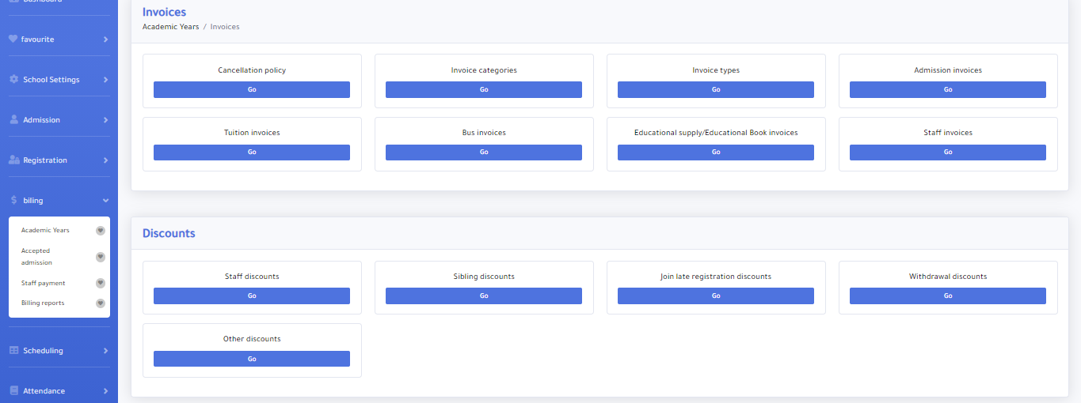
Payment System
The system covers all payments related to admission, enrollment, tuition fees, transportation fees, and book fees.
It also includes payment discounts such as staff discounts and any other discounts defined by the nursery.
The system supports refund policies and the application of payment and refund conditions.
Online payment is enabled through integration with KNET, My Bill, or any other payment gateway provided by the nursery.
Payments can be made electronically via the nursery’s website or mobile application.

Slide 9
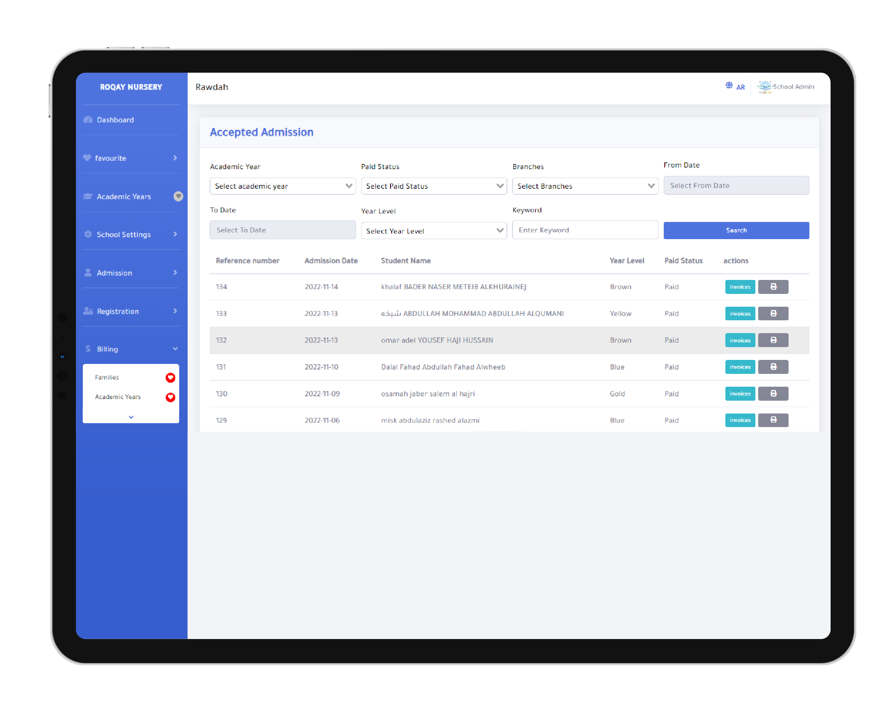
Accounting & Subscriptions (Installments)
Configure fee settings for each academic year based on fee type and educational stage.
The system also supports payment discounts such as sibling discounts, staff discounts, and any other discounts defined by the nursery through:
Setting up discount rules.
Applying discounts to student fees.
Billing in the system is subscription-based, allowing parents to choose flexible payment plans (monthly, quarterly, annually, or for a custom number of months).
The system also includes withdrawal and exit policies.

Slide 10
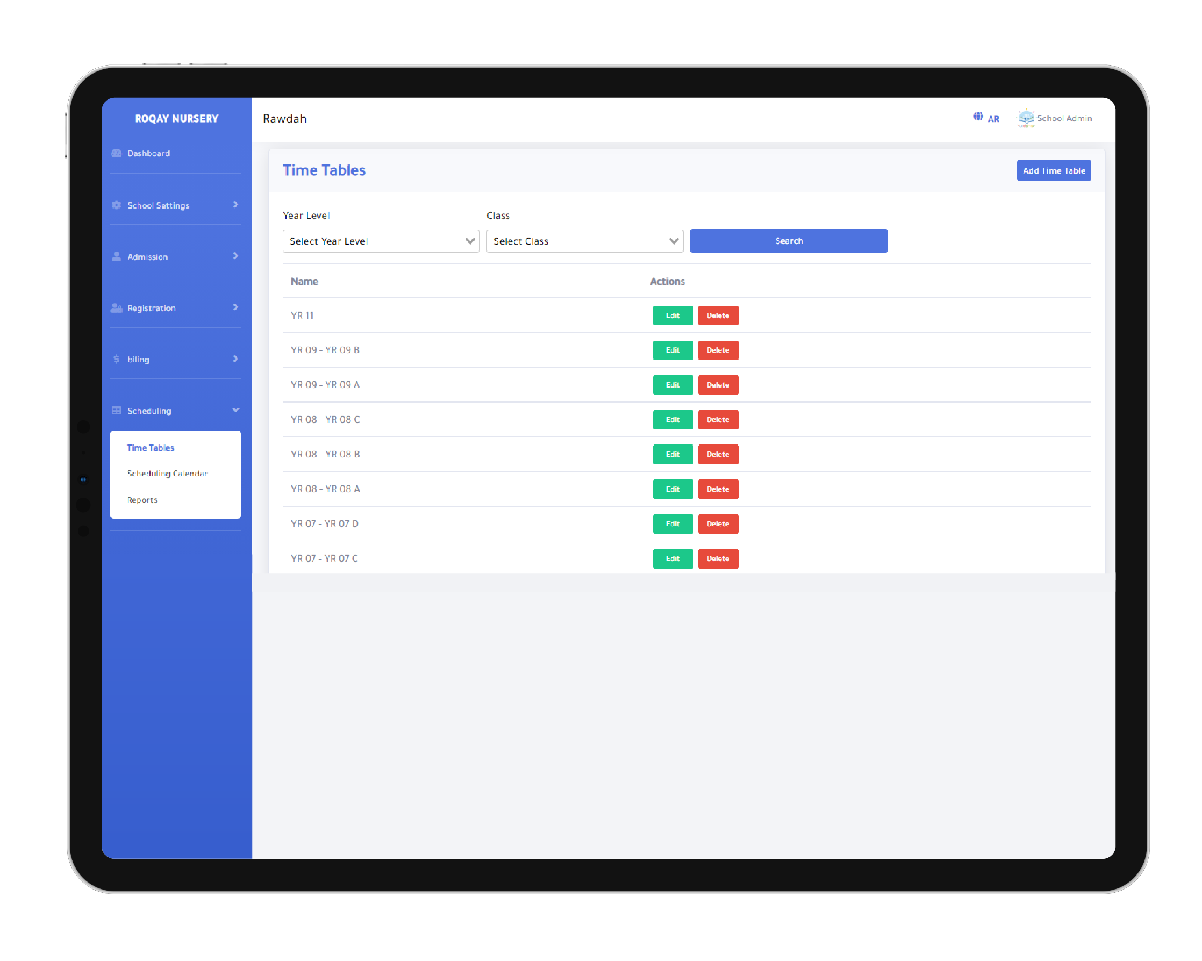
Timetables
The system administrator can set up all required data for creating timetables, such as the number of daily classes and the nursery’s working days.
Timetables can be created for each class by selecting the educational stage and class, then assigning subjects and the teachers responsible for each subject.
The administrator can define the nursery’s academic calendar, including working days, holidays, and the start of the week.
The system also provides timetable reports for teachers, classes, and subjects.

Slide 11
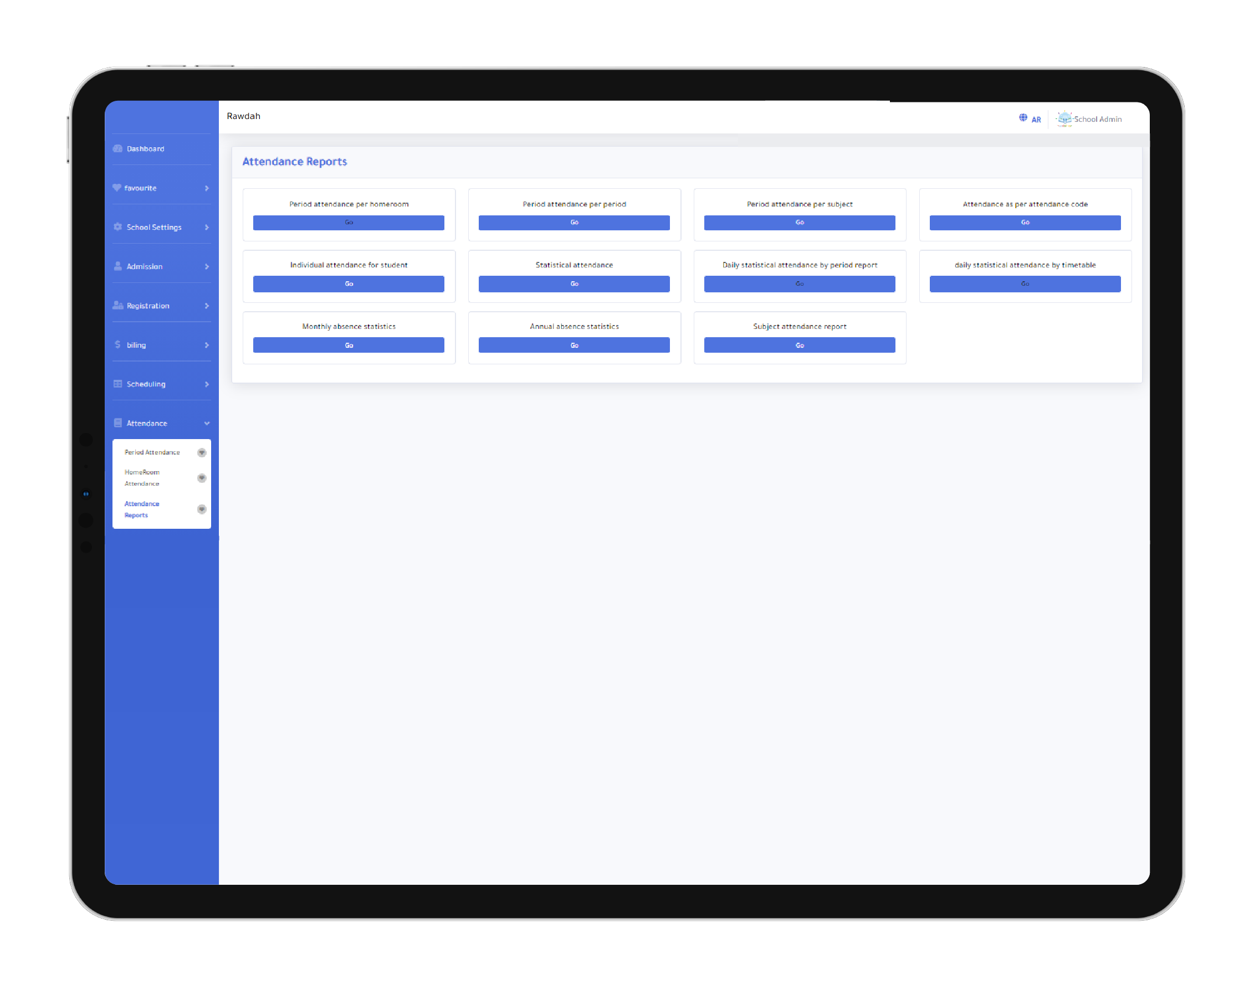
Student Grades
The system allows calculating students’ grades by entering subject marks into a structure of columns, factors, and weighted scales.
The final subject grade is calculated using formulas such as total, average, or any calculation method defined by the nursery.
Parents can continuously monitor their child’s grades through the nursery’s website and mobile application.

Slide 12
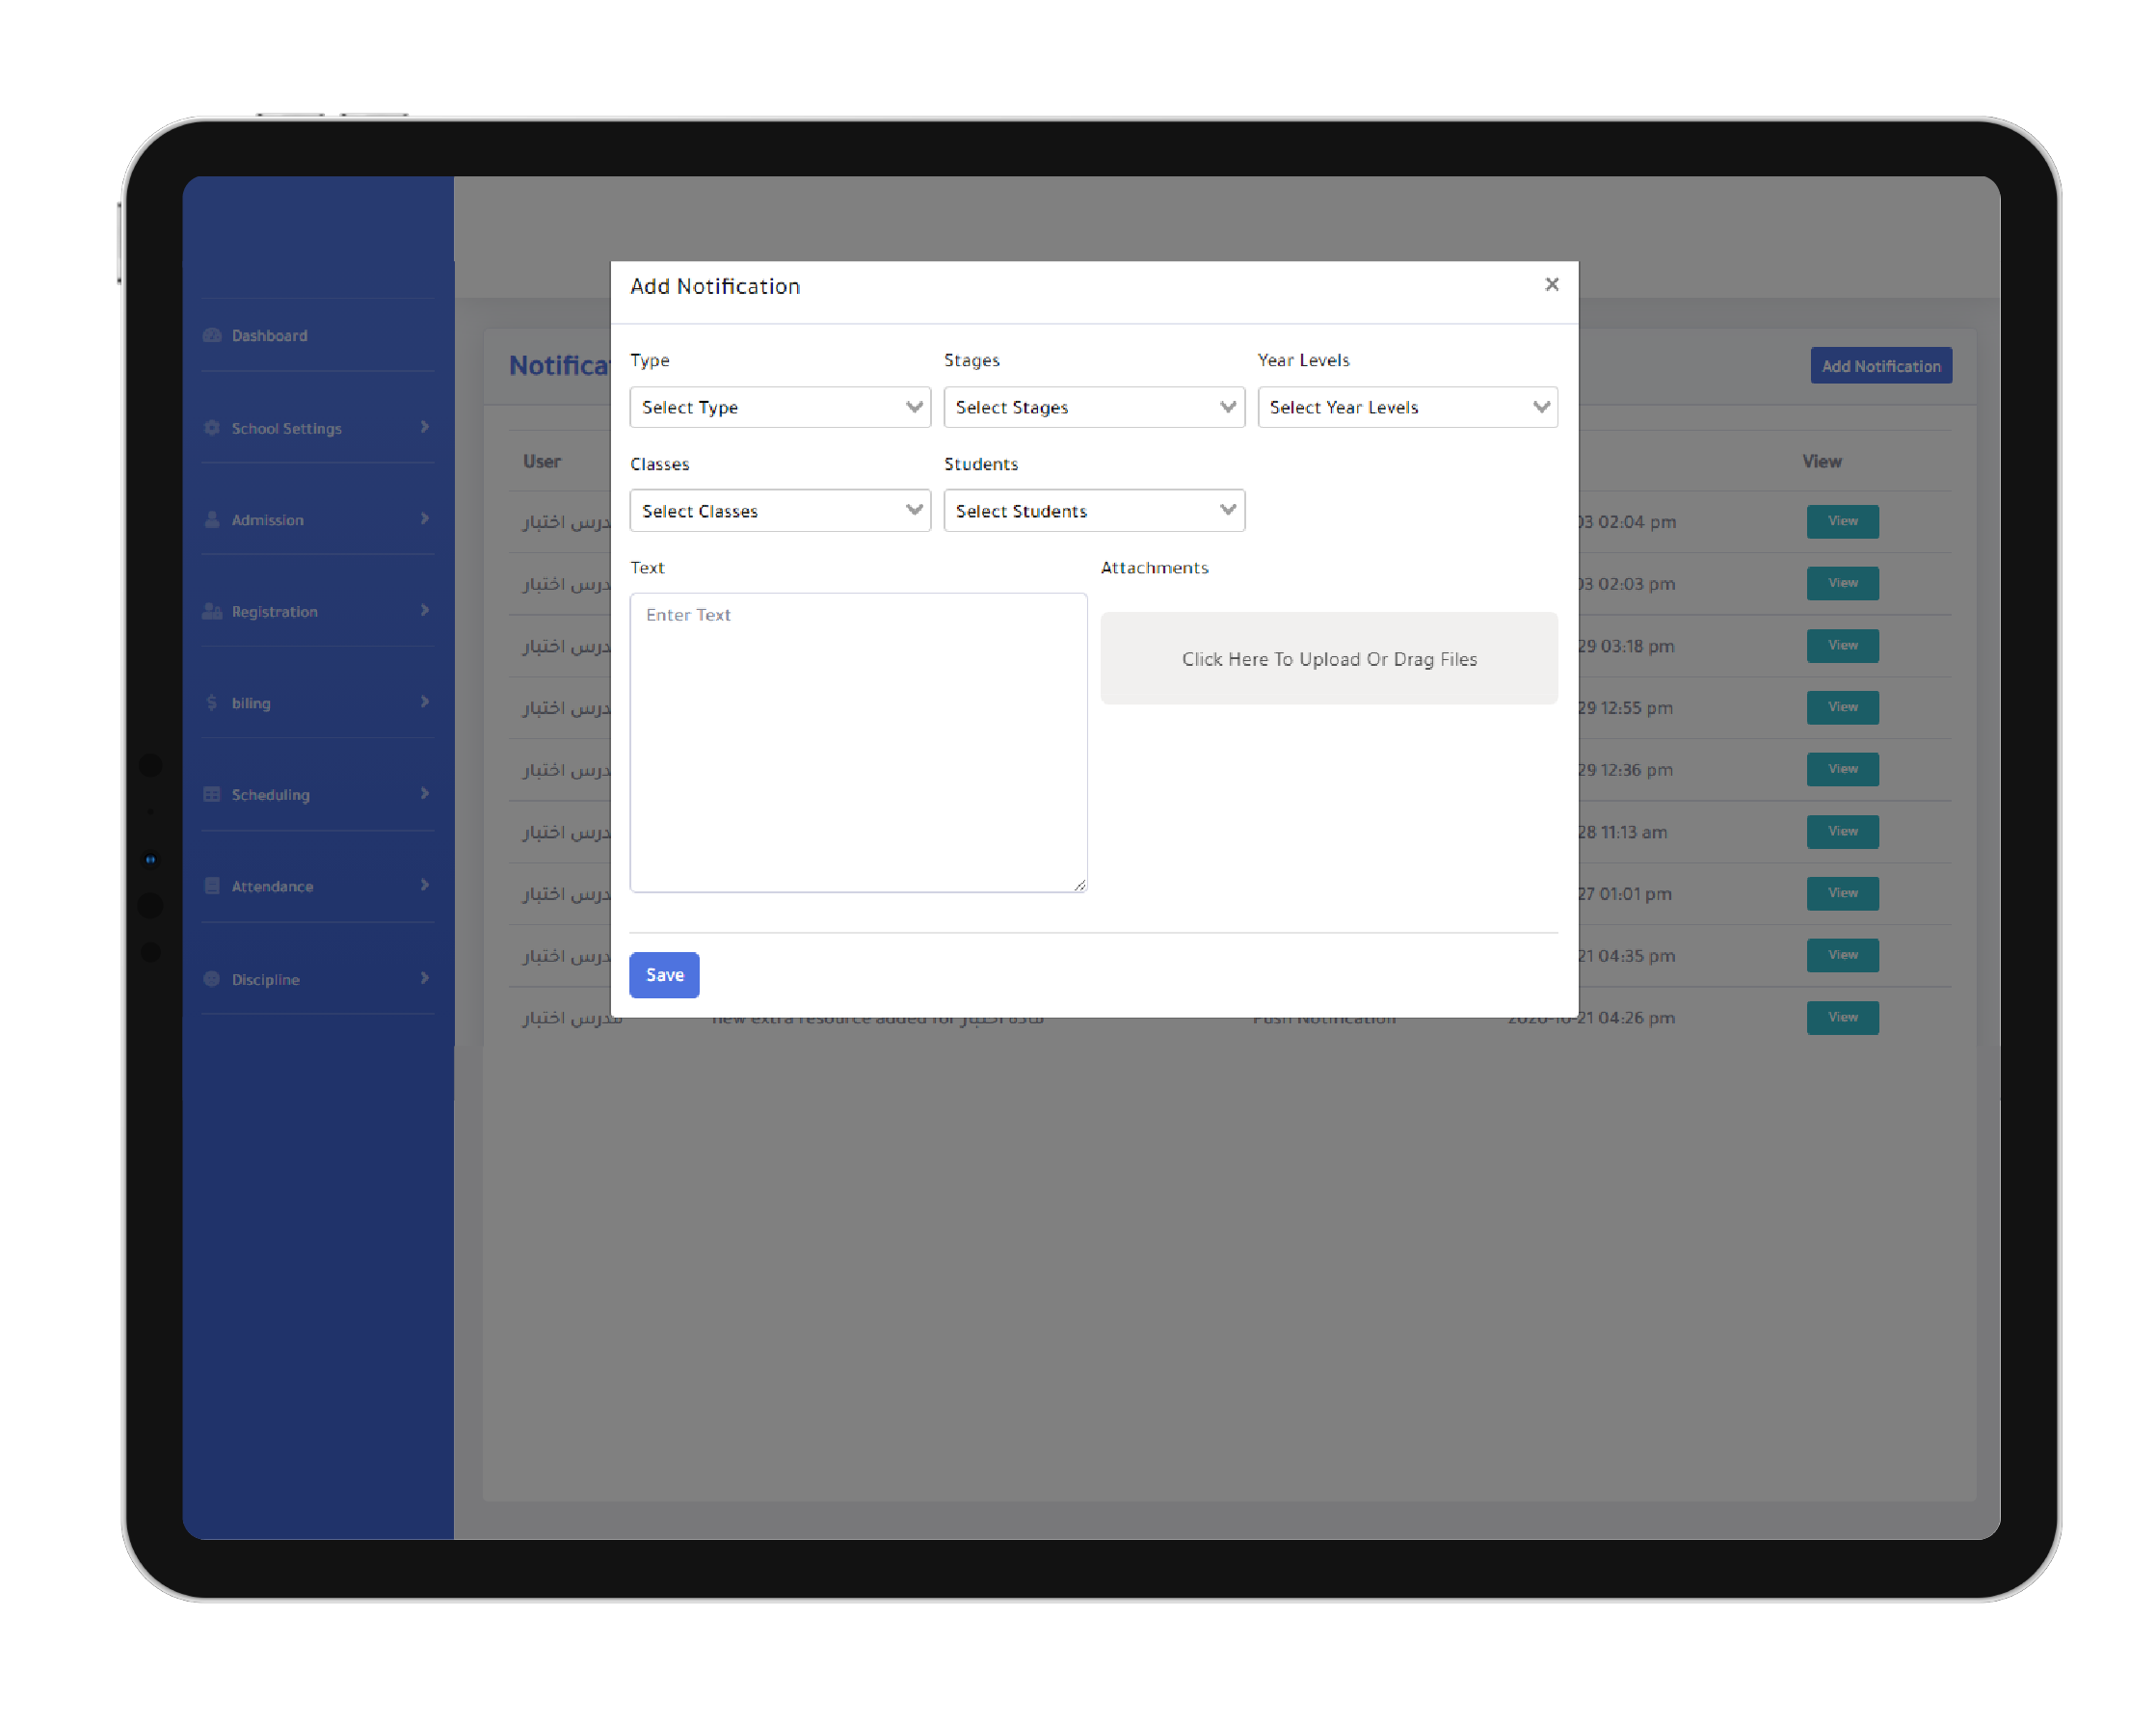
Notifications
The system allows sending notifications to students and parents at different levels: nursery-wide, class level, individual student, or a specific group of students.

Slide 13
Announcements
Rawdah supports sending announcements to students and parents at the nursery level, class level, individual student, or a specific group of students.

Slide 14

Printable Documents
The system provides the ability to print official nursery documents such as transfer letters, clearance certificates, or any other documents the nursery wishes to generate.

Slide 15

E-commerce Store
The E-Store is a fully integrated feature that enables the nursery to showcase and sell products and services to parents in a simple and secure way.
Through this feature, the nursery can add products such as uniforms, books, educational materials, and toys. Parents can browse and purchase these products directly using various online payment methods.
The system also provides inventory management, along with the option to activate promotional coupons.
This feature helps the nursery create an additional revenue stream, simplifies the purchasing experience for parents, reduces administrative effort through automation, and supports decision-making with accurate and transparent reports.

Slide 16
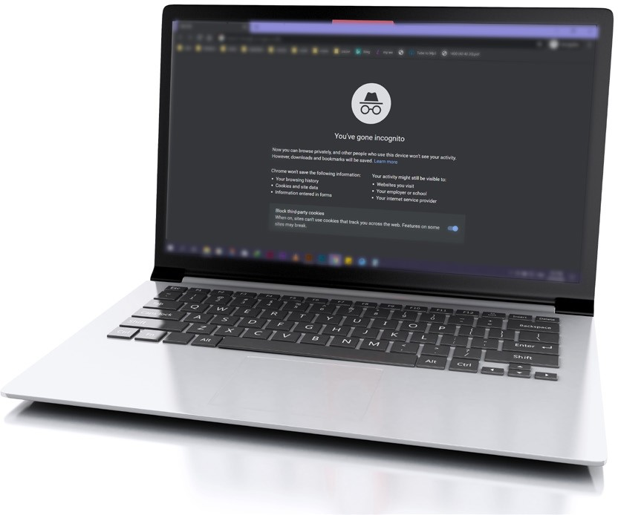

System Logs
Nothing is hidden in our system
The system records all activities performed within the platform, including the user who carried out the action, along with the date and time. This allows the administrator to track everything happening in the system and identify the responsible users.
Everything is archived and fully traceable.

Slide 17

Parents
Users & Permissions
The system provides the ability to define all roles that can access the platform and assign specific permissions to each role based on its nature.
It also allows adding new users and assigning a role to each user individually.
Students

Slide 18
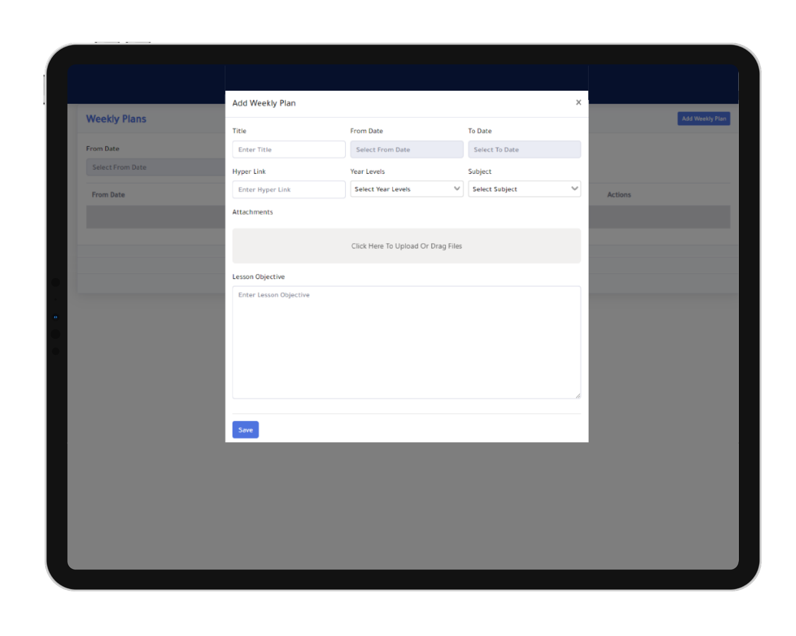
Teachers & Department Heads Dashboard
Department Heads’ Permissions
Monitor messages between teachers and parents.
Add weekly lesson plans for each subject and educational stage.
Schedule exams for each subject and stage.
Upload worksheets related to the subjects and stages they supervise.
Assign student homework and extra courses to improve academic performance.
Track student absences.
Publish announcements to parents.
Monitor student grades.
Review and manage field trip requests.

Slide 19
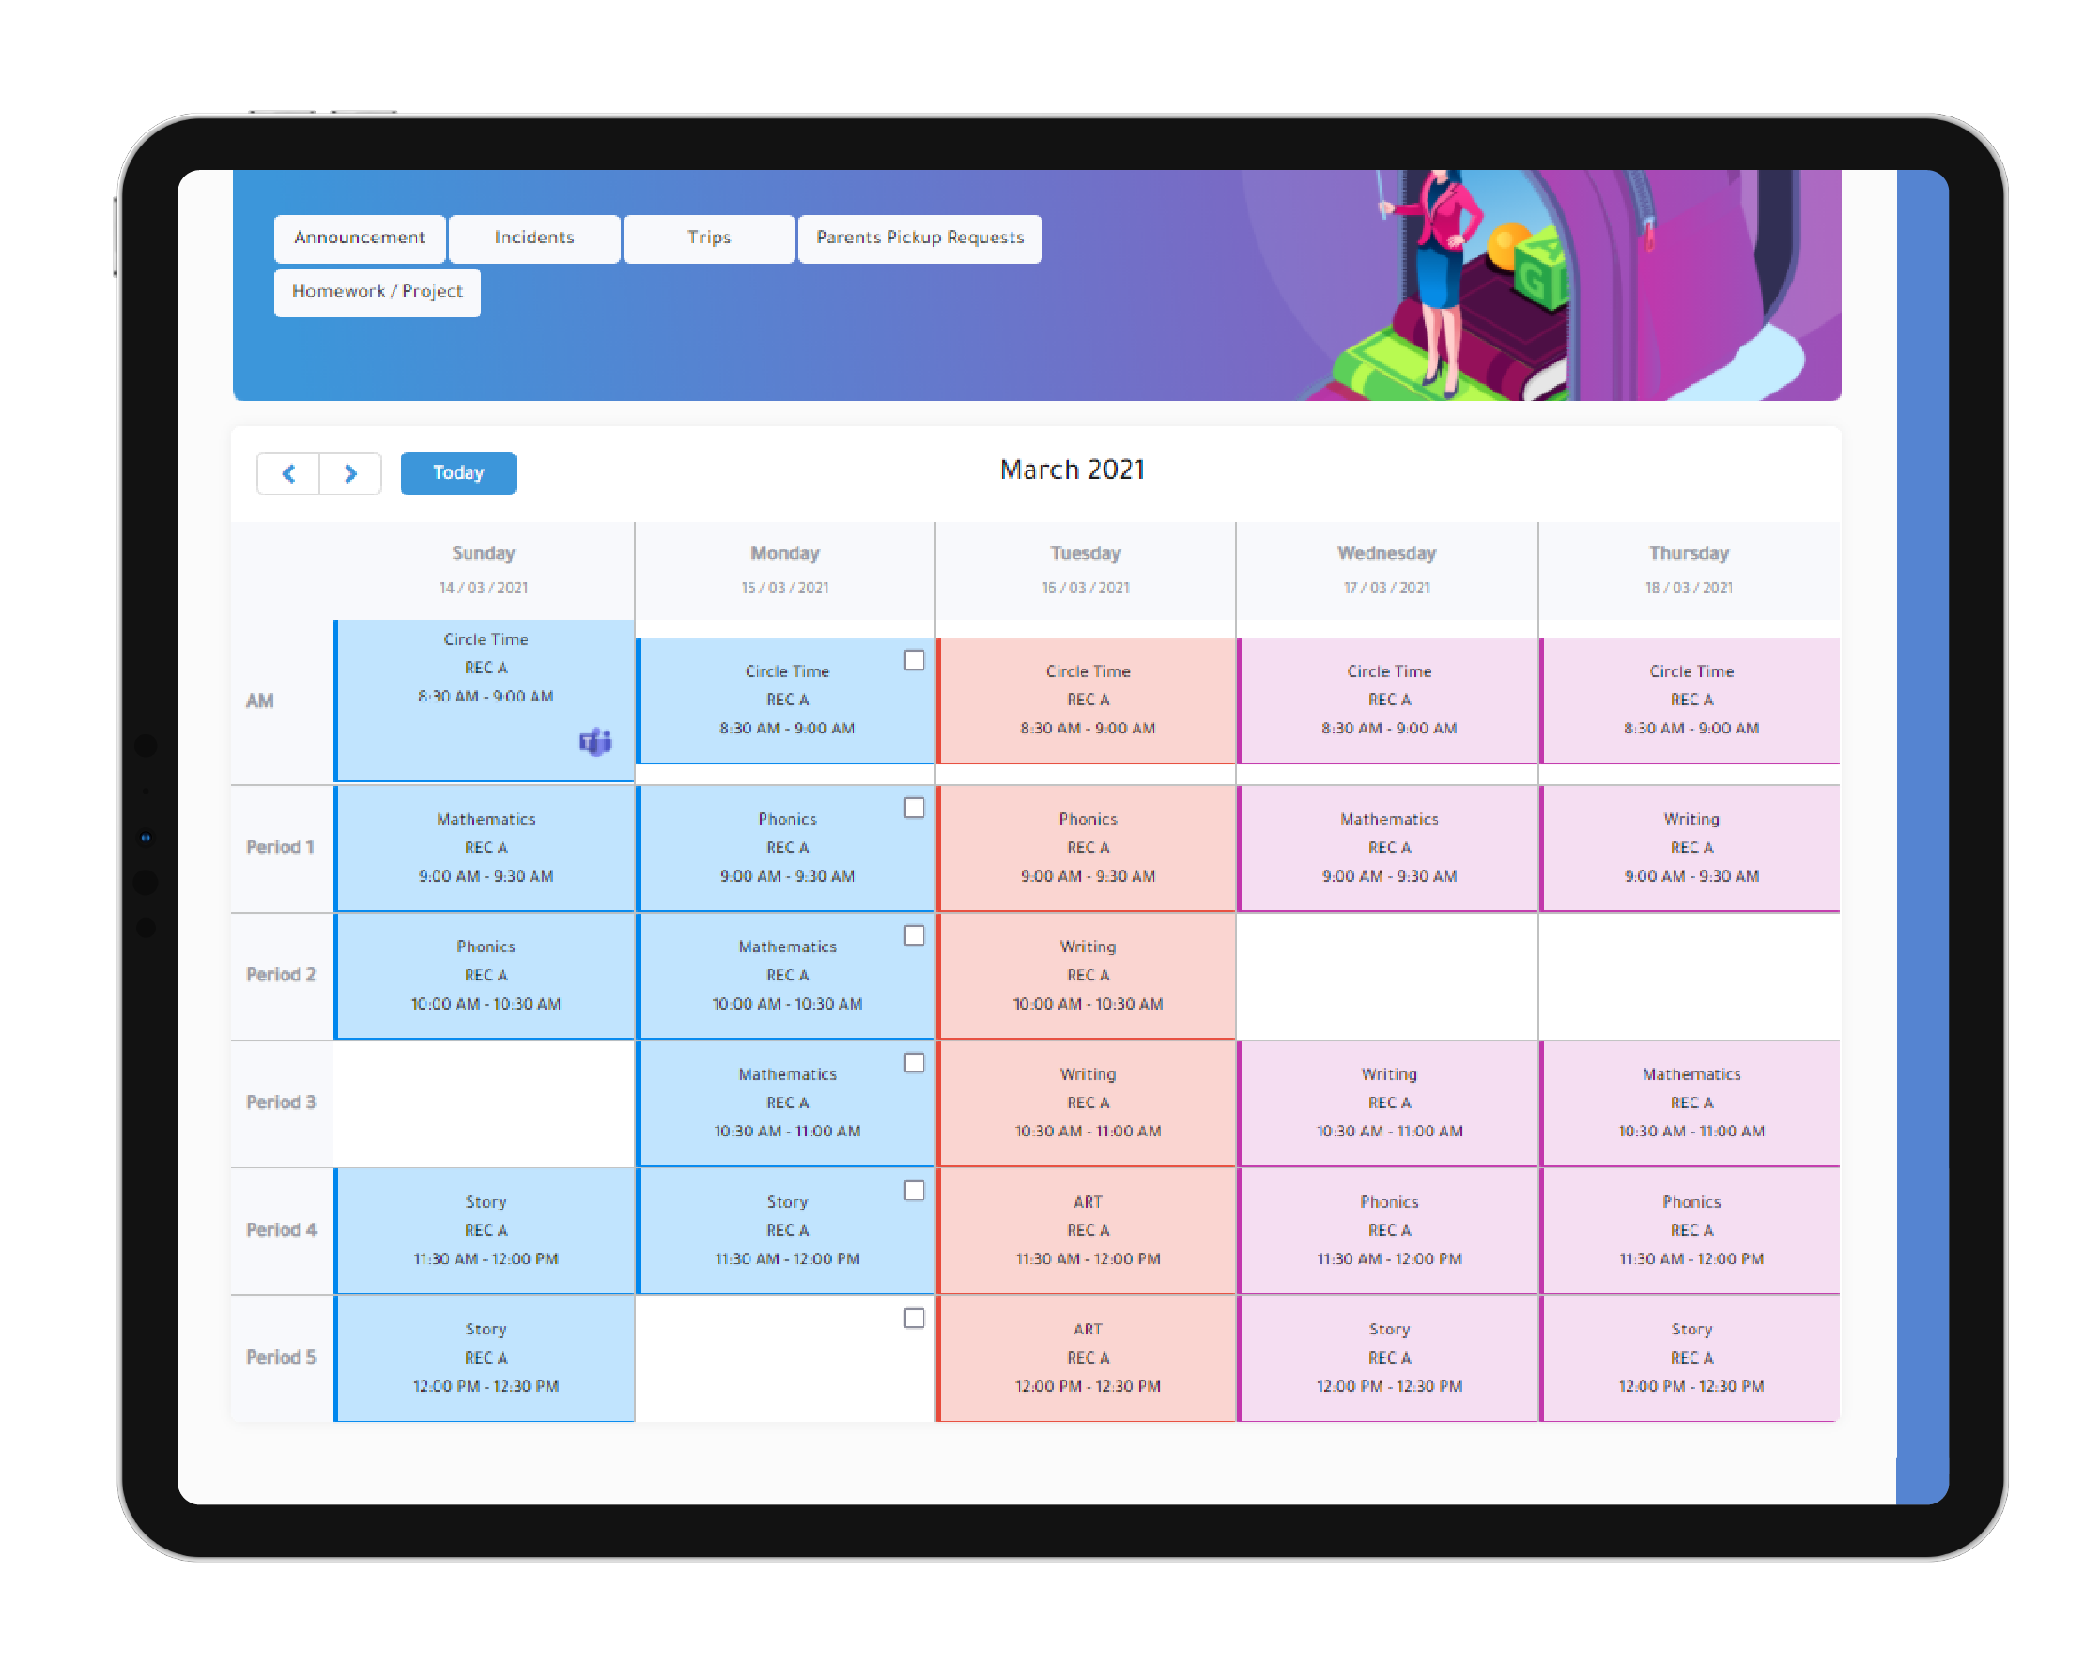
Teacher Dashboard
Teachers can:
View their personal timetable.
Start online sessions with their class via Microsoft Teams or Big Blue Button.
Add lessons, assignments, and additional learning resources for students.
Enter and manage student grades.
Record student attendance and absences.

Slide 20
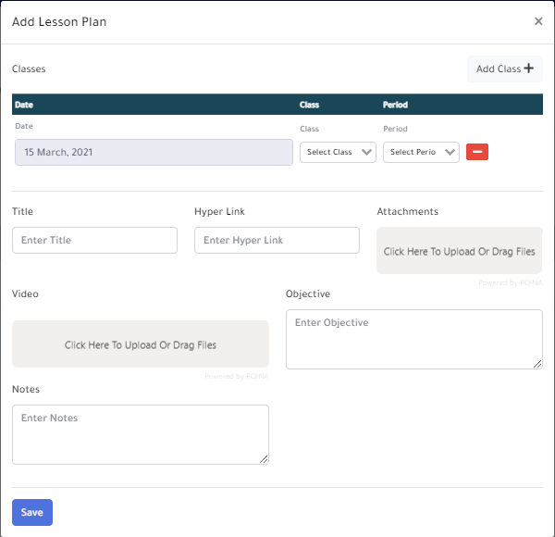
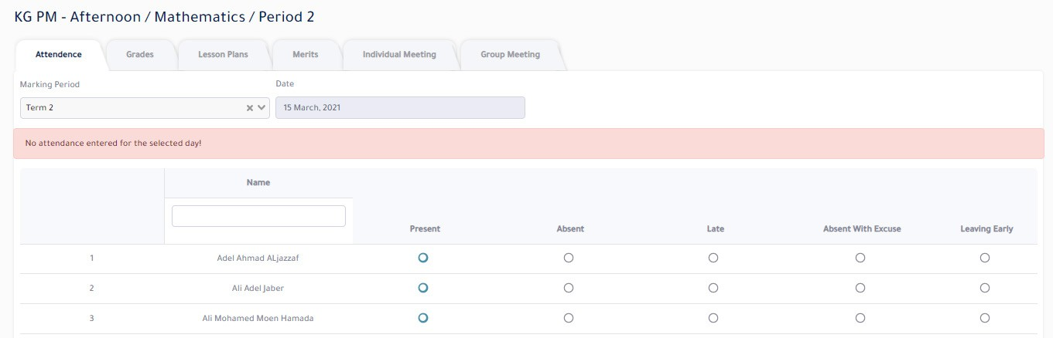
View messages sent by parents and communicate with them directly.
Add rewards for students or deduct grades when necessary.
Schedule available slots for one-on-one meetings with parents.
Track parent meeting requests.
Monitor bus service requests.
Submit field trip requests.

Slide 21
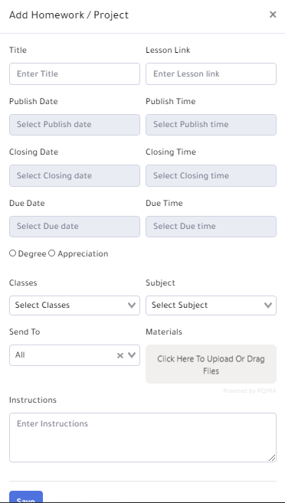
Assignments and Documents

Slide 22

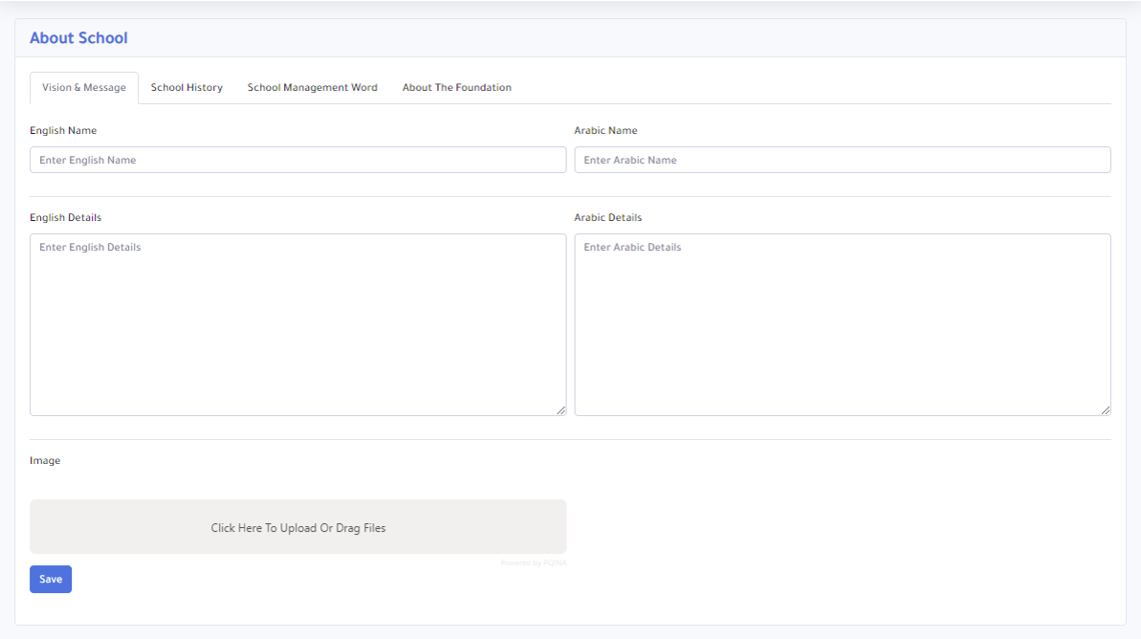
Assignments & Documents
Nursery Website (for Students & Parents)
The nursery’s website consists of two sections:
Section One:
Showcases nursery information in an attractive way for site visitors.
Section Two:
Dedicated to parents and students, enabling them to monitor student behavior, lessons, and interactions with teachers. It also allows completing online payments.
Students can follow their lessons and grades, as well as attend virtual learning sessions with teachers through the system.

Slide 23
Assignments & Documents Nursery Website
(for Students & Parents)
Students and parents can track studies, assignments, and additional resources.
Students and parents can monitor grades and evaluations.
Students and parents can view the timetable and attendance records.
Parents can book one-on-one meetings or parent-teacher conferences.
Parents can send messages to teachers and receive messages and notifications.
Students can attend virtual classes with teachers through the system using Microsoft Teams or Big Blue Button.
Parents can submit requests to prevent the student from boarding the bus.
Parents can pay nursery fees online.

Slide 24
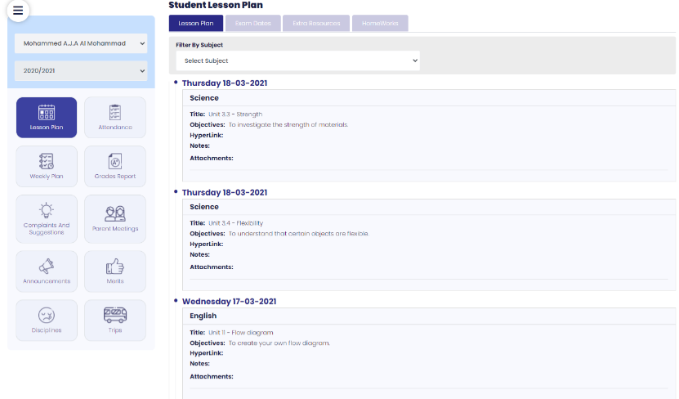
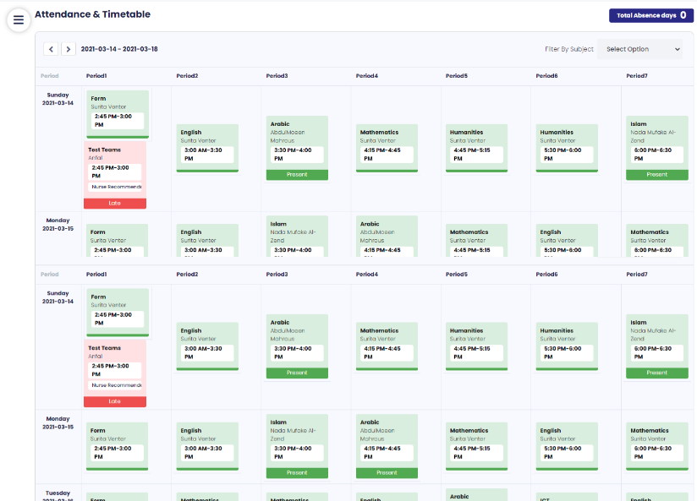
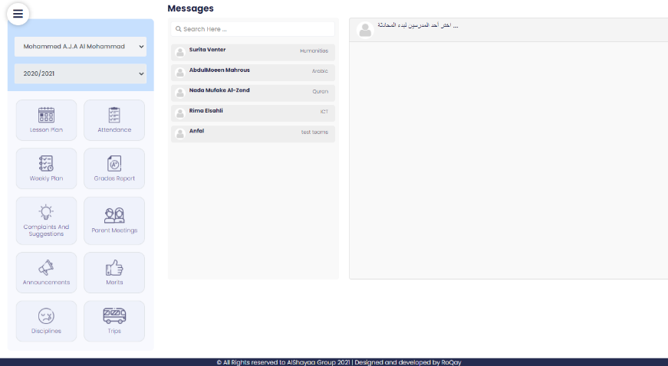
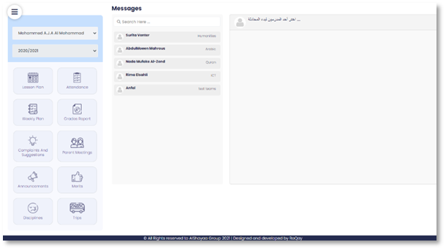
Sample Screens for Students & Parents
Attendance & Timetable
Lesson Plan
Messages

Slide 25
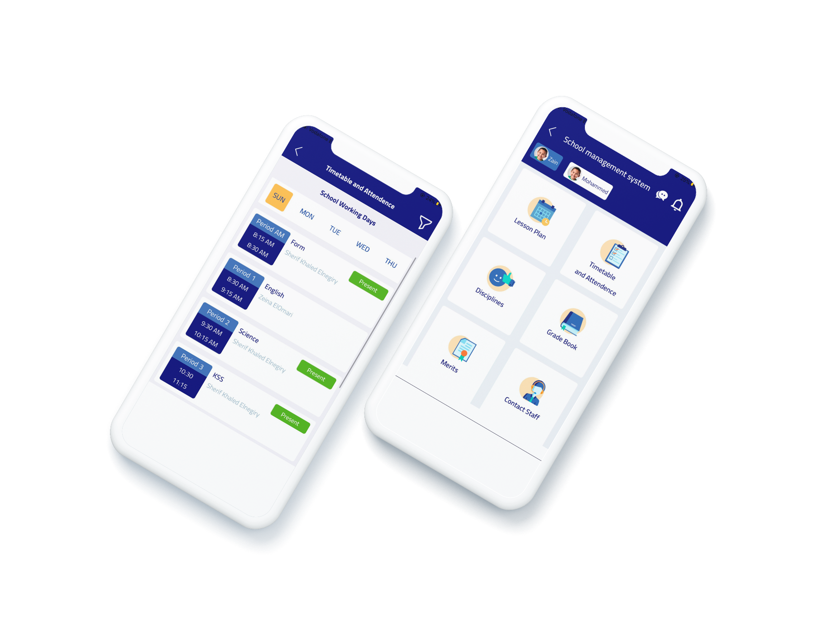
Application (for Students & Parents)
Students and parents can track studies, assignments, and additional learning resources.
Students and parents can monitor grades and evaluations.
Students and parents can view the timetable and attendance records.
Parents can book one-on-one meetings or parent-teacher conferences with teachers.

Slide 26
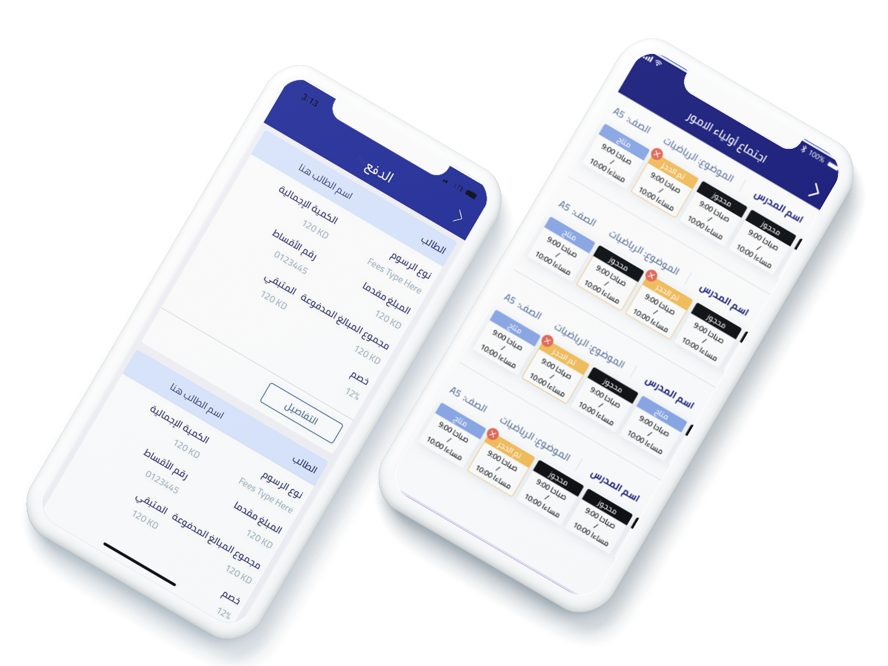
Parents can send messages to teachers and receive messages and notifications.
Students can attend virtual lessons with teachers through the system using Microsoft Teams or Big Blue Button.
Parents can submit requests to prevent their child from boarding the bus.
Parents can pay nursery fees online.

Slide 27
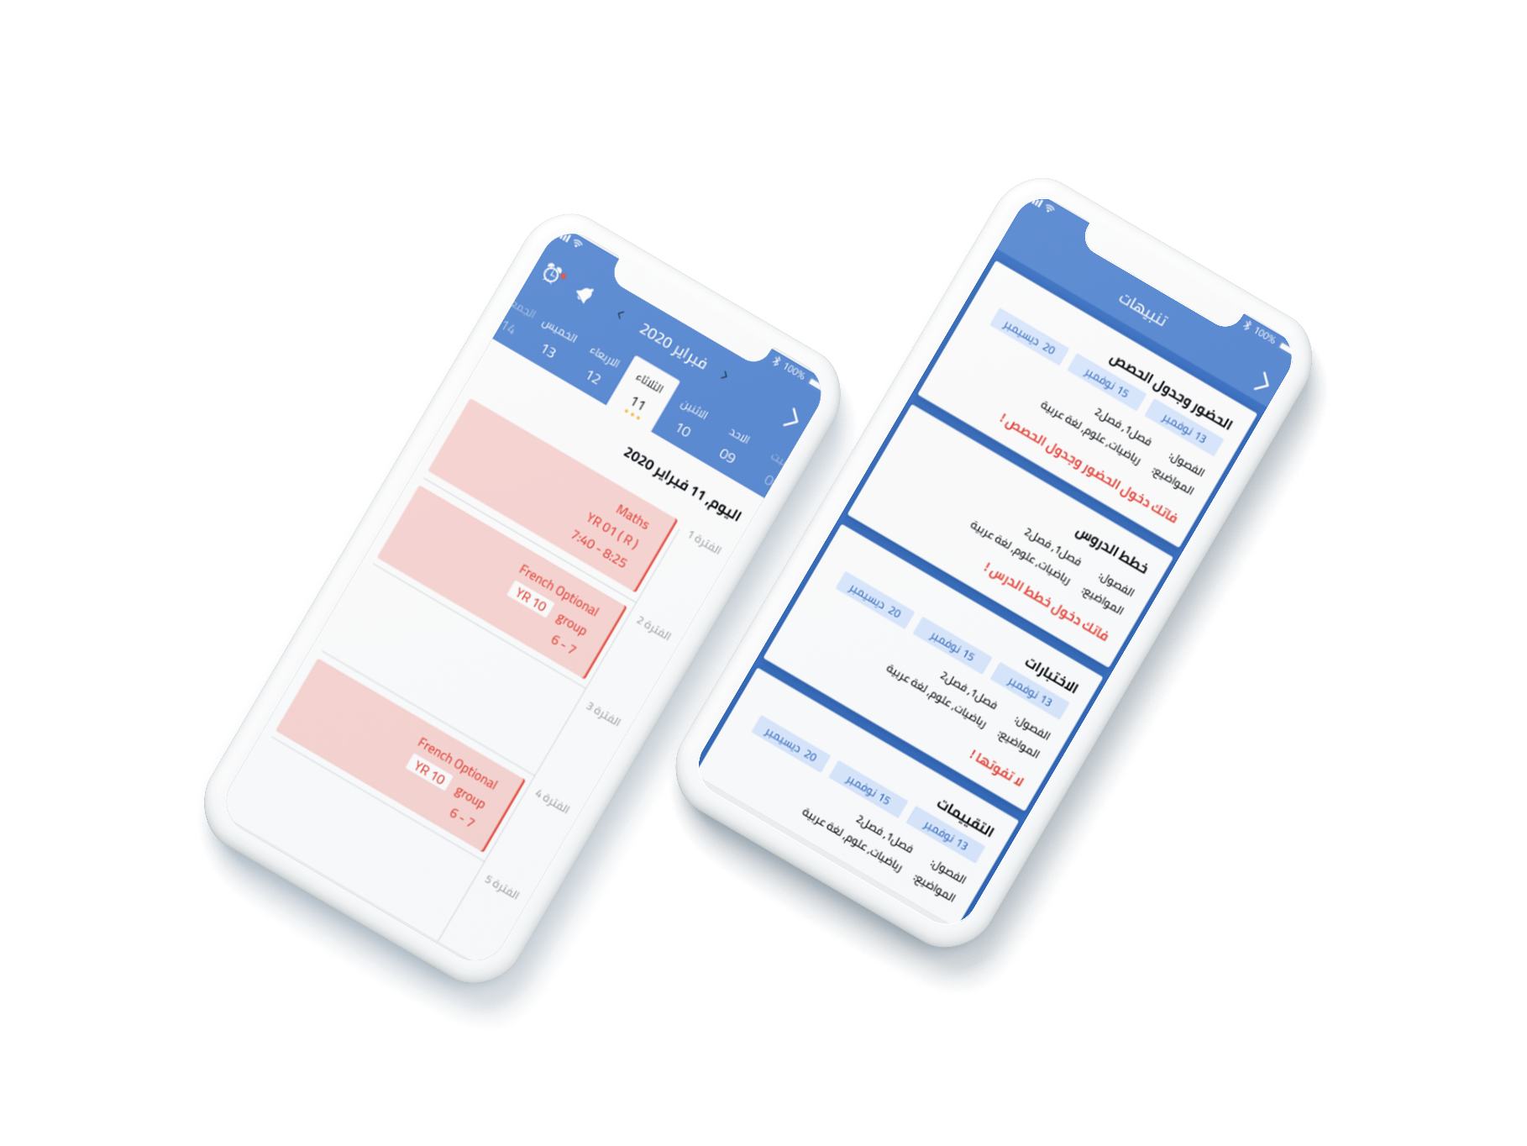
Parent Mobile Application
Through the app, teachers can:
View their class timetable.
Enter and manage student grades.
Start online sessions with students.
Add lessons, assignments, and additional resources for students.
Record student attendance and absences.
View messages from parents and communicate with them directly.
Schedule available time slots for one-on-one meetings with parents.
Track parent meeting requests.

Slide 28
Integration and Connectivity with Other Systems
The system is distinguished by its ability to integrate and connect with various external systems, providing greater efficiency and enhanced functionality.
For example:
Integration with online classroom platforms such as Microsoft Teams.

Slide 29
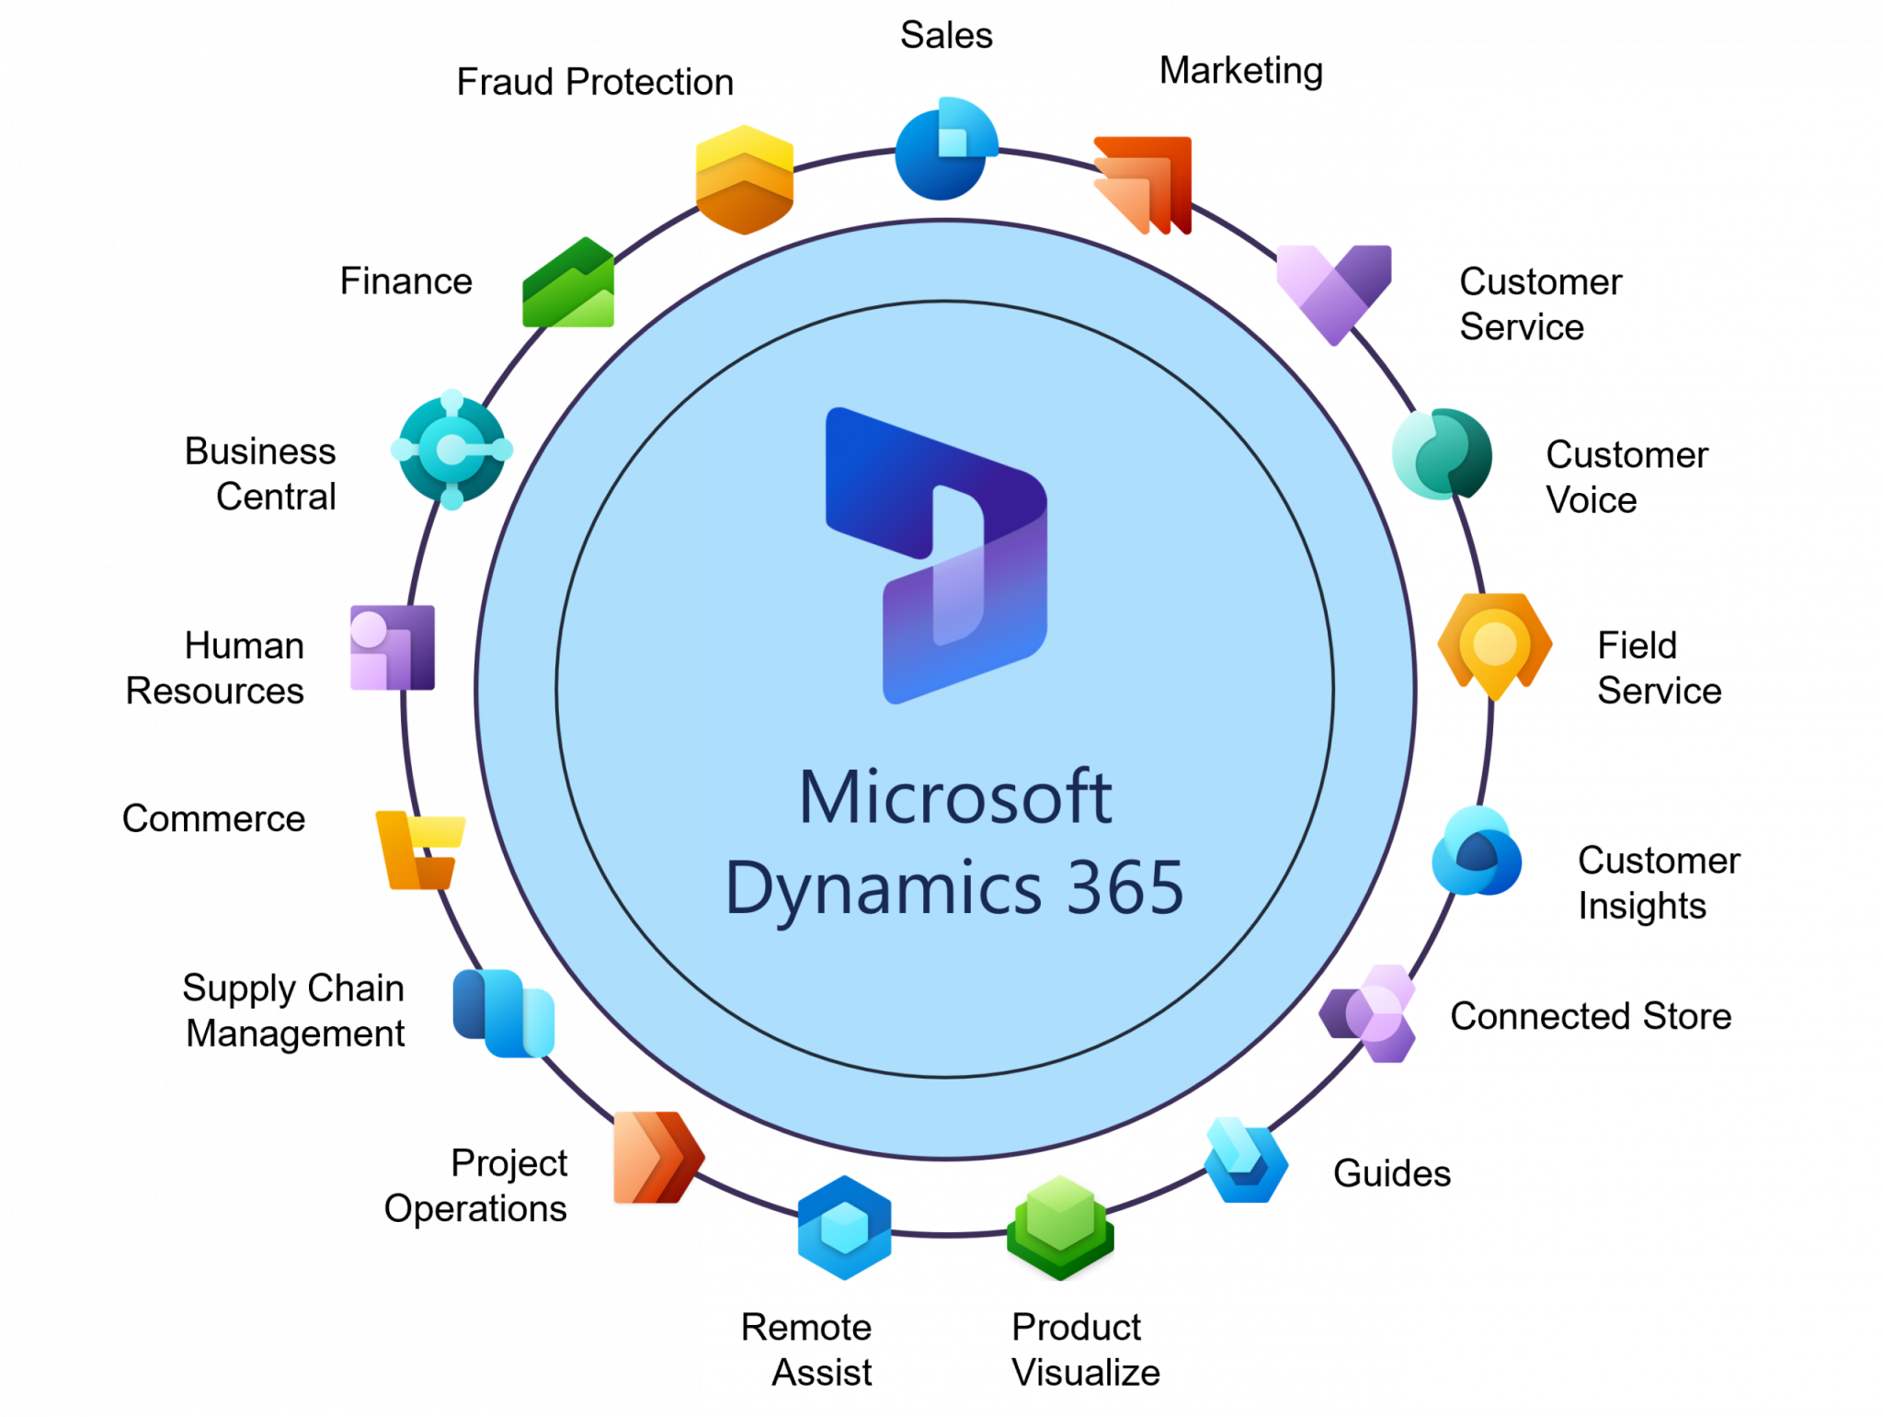
Integration and Connectivity with Other Systems
Integration with Microsoft Dynamics
The system is directly integrated with Microsoft Dynamics to automatically and instantly transfer all revenue and payment data. This ensures unified financial information across platforms, continuous real-time updates, reduced errors from manual entry, and enhanced accuracy and speed of financial reporting.

Slide 30
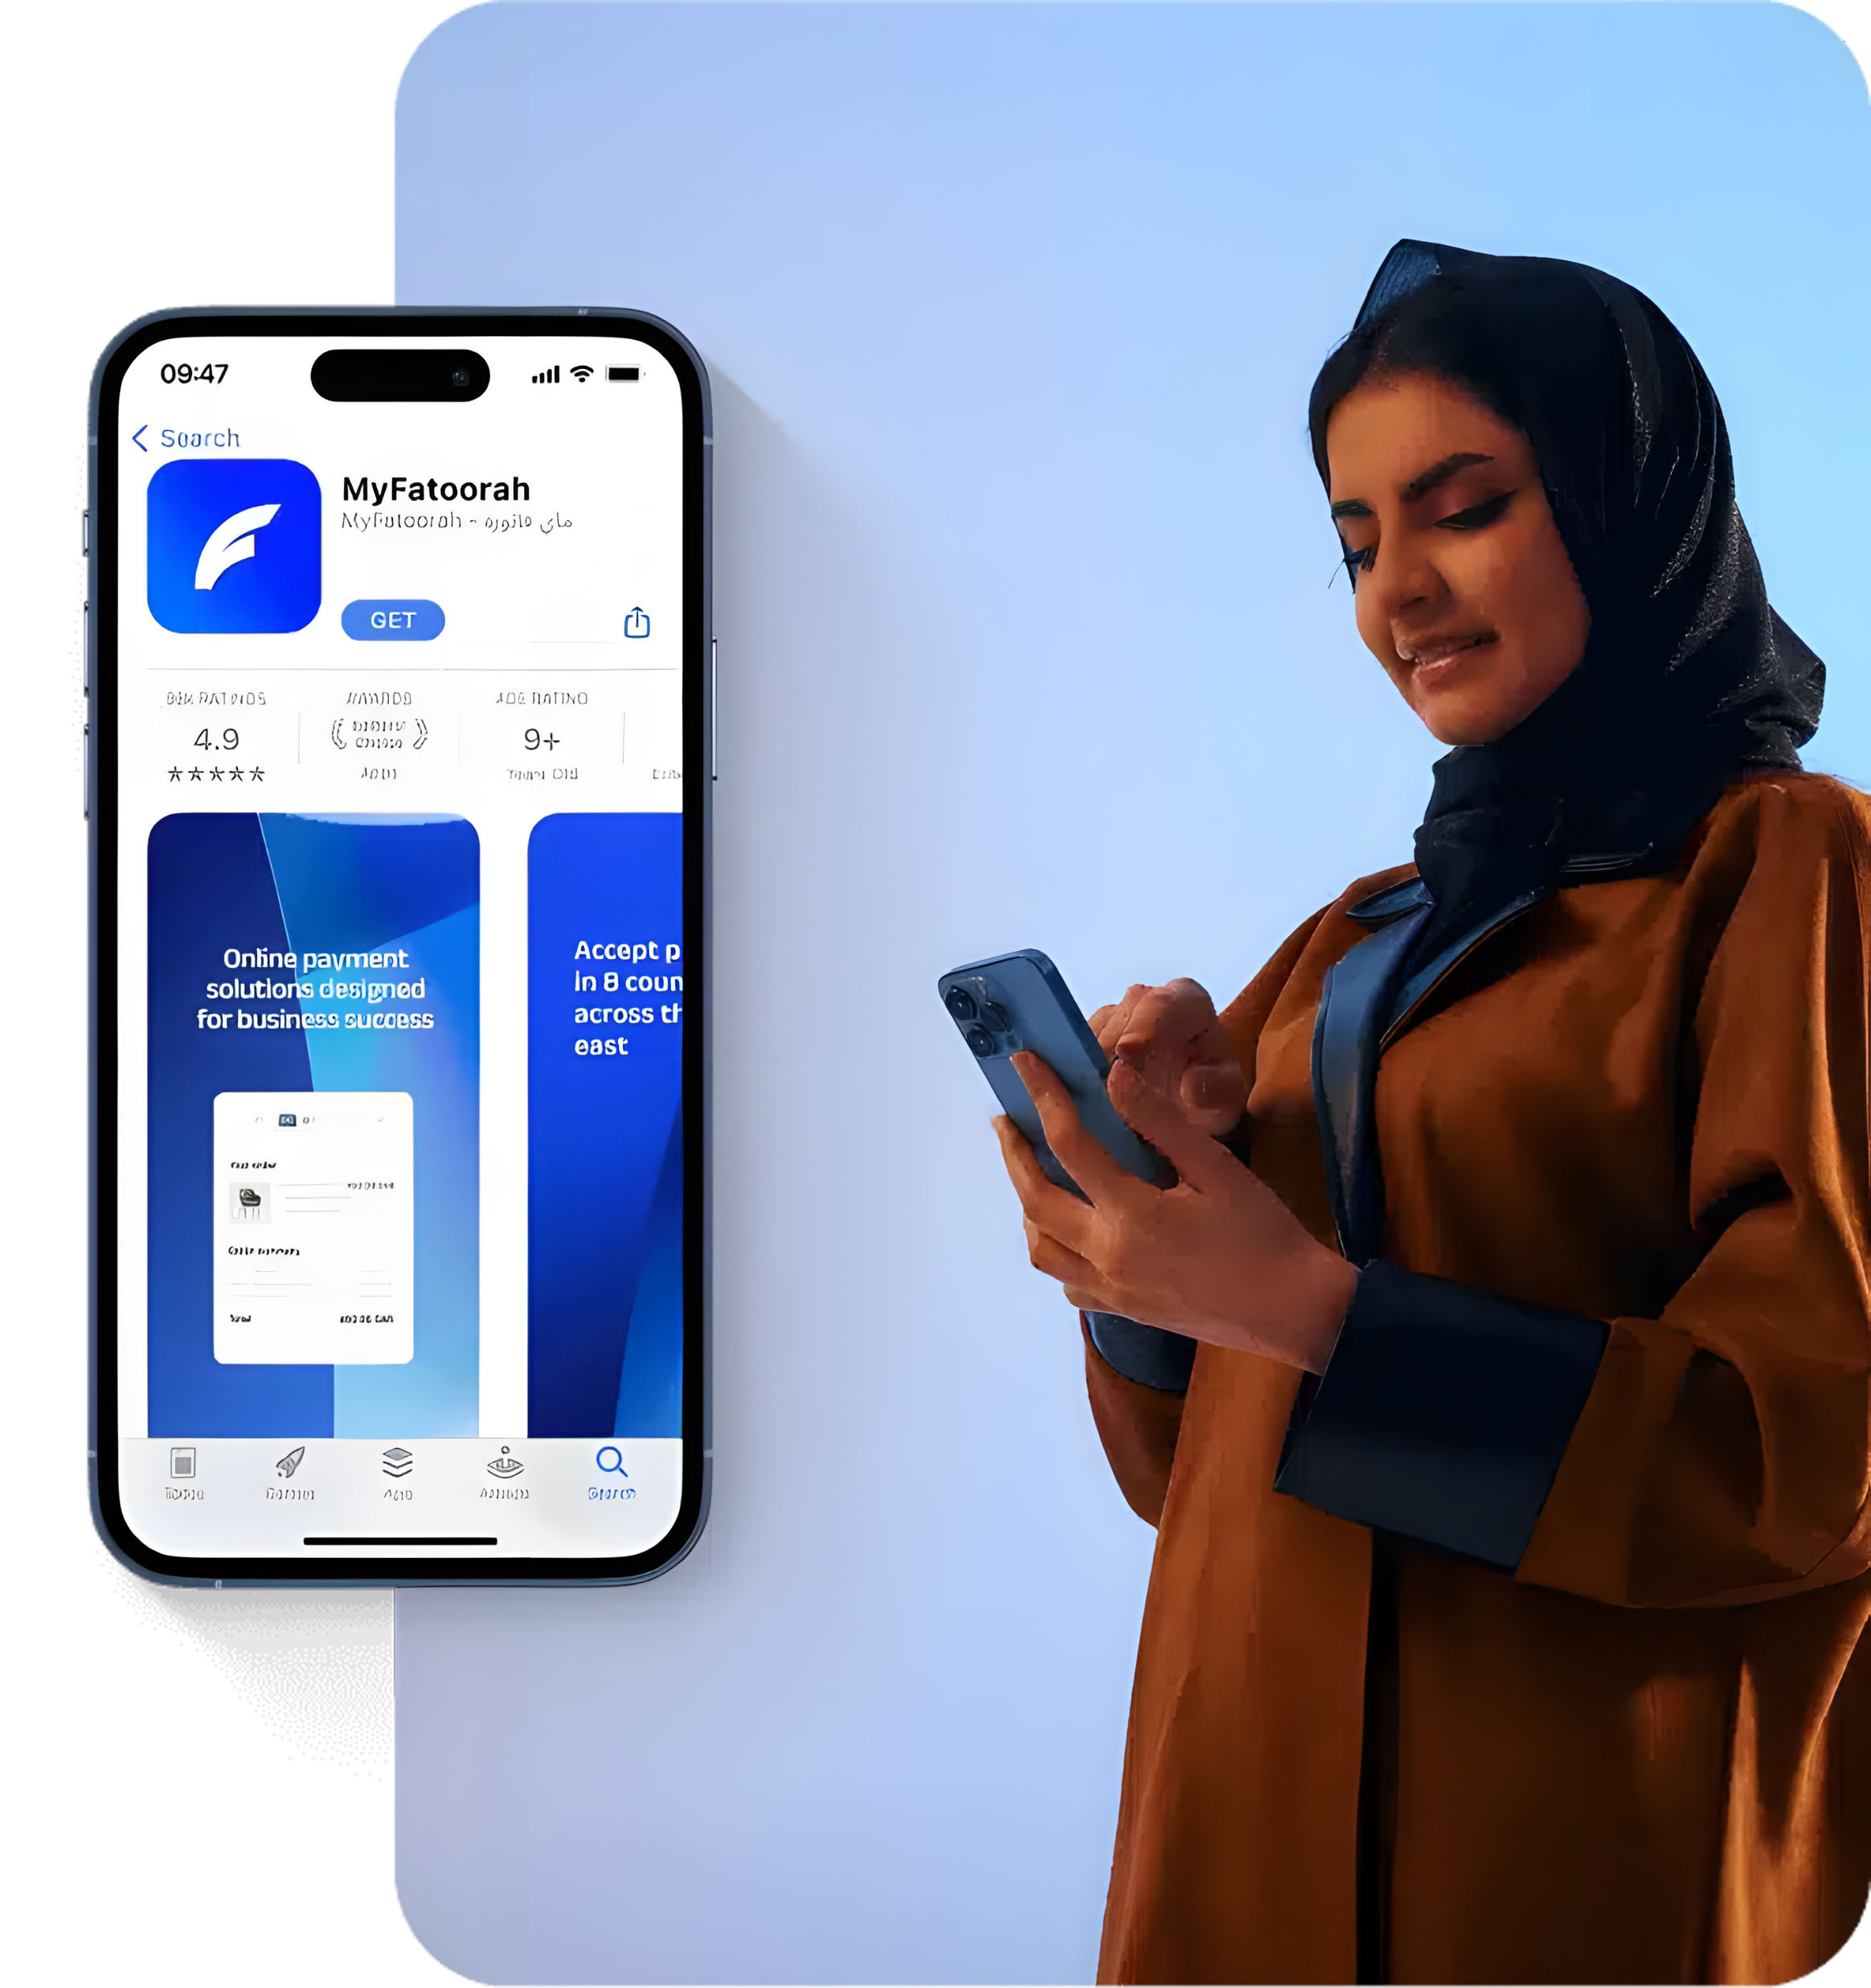
Integration and Connectivity with Other Systems
The system supports integration with various online payment gateways, such as My Fatoorah, enabling parents to pay fees and purchases easily and securely.
Through this integration, financial transactions are updated instantly within the system. This helps simplify the collection process, reduce reliance on cash, improve financial data accuracy, and enhance the user experience by allowing payments anytime and from anywhere.

Slide 31
Microsoft Teams Integration Features
Meet anyone, anywhere
Host online meetings for two people or for groups of up to 10,000, with a unified and consistent experience across all platforms.
Leverage smart insights
Make online meetings more effective by sharing context and content, while leveraging AI to enhance collaboration.
Secure meetings you can trust
Enjoy safe online meetings with high-quality audio and video, along with reliable screen sharing.
Seamless content sharing
Easily share content and collaborate with others during meetings through smooth integration with Microsoft 365.
Enhanced privacy with video controls
Preview your video and audio before joining a meeting. Turn on video to boost engagement with remote participants, and use intelligent background blur to maintain focus and minimize distractions.
Meeting recordings
Record audio, video, and screen sharing during Teams meetings. The automatic transcription feature allows you to review discussions and search through text for key points.

Slide 32

Storage Capacity
The company will provide 2TB of storage with the system to accommodate the largest possible amount of educational files uploaded by the nursery.
The nursery will bear the cost of additional storage if it wishes to expand beyond the provided capacity.

Slide 33

Security Systems
We have strengthened the system’s reliability and performance by implementing international quality standards. The system has undergone rigorous Penetration, Security, and Code Testing to ensure it operates as a fully integrated, high-quality solution.
As part of the annual maintenance contract, the company conducts security testing every six months, addressing and resolving any vulnerabilities identified in the system.

Slide 34

AWS Cloud Security
Amazon Web Services (AWS)
Enhance your security posture with the infrastructure and services provided by Amazon Web Services (AWS). With AWS, you gain the control and confidence needed to securely run your business on the cloud, leveraging the world’s most flexible and secure computing environment.
As an AWS customer, you benefit from Amazon’s data centers and global network, purpose-built to protect your information, identities, applications, and devices. AWS enables you to meet core security and compliance requirements such as data locality, protection, and confidentiality while automating manual security tasks so you can focus on scaling your business and driving innovation.
Additionally, AWS offers a pay-as-you-go model, meaning you only pay for the services you actually use. All AWS customers benefit from being on the only commercial cloud platform that has undergone extensive security assessments of its service offerings and supply chain, and has been recognized as secure enough to handle the world’s most sensitive and highly classified workloads.
Amazon Web Services (AWS) is the world’s most comprehensive and widely adopted cloud platform, offering more than 175 fully featured services from data centers globally. Millions of customers—including fast-growing startups, large enterprises, and leading government agencies—use AWS to reduce costs, increase agility, and accelerate innovation.

Slide 35

Benefits of AWS Cloud Security
Secure Scalability with First-Class Visibility and Control
Automation and Risk Reduction with Highly Integrated Services
Built with the Highest Standards of Privacy and Data Protection
The Largest Ecosystem of Security Partners and Solutions
Access to the Most Comprehensive Security and Compliance Controls

Slide 36

Deliverables
Admin Dashboard with system management and
role-based permissions.
Teacher Dashboard for class, student, and academic management.
Web & Mobile Dashboards with dedicated functionalities.
Website for students, parents, and teachers.
Mobile Application for students, parents, and teachers.
Cloud Storage with 2TB capacity.

Slide 37

Technical Stack
Backend Development: PHP with the powerful Laravel framework.
Frontend Development: Bootstrap with HTML & CSS.
Website CMS: WordPress.
Database: MySQL.
Mobile Applications: Custom apps for both iOS and Android.

Slide 38

Future Plan
Our company strongly believes in the importance of continuous development to ensure that our systems operate efficiently for years to come while keeping pace with the latest technologies available in the market. The company has already begun enhancing this system by adding new services and developing additional systems that can be integrated to increase its efficiency and comprehensiveness.

Slide 39
Here is a list of the future plans that will be worked on soon:
Electronic curricula system and e-learning content management.
The system automatically creates timetables after entering some data such as teachers' data, subjects, classes, and halls.
A system to distribute non-teaching tasks to teachers according to their abilities, their roles in the nursery, or their assigned timetables.
Integration with other educational systems such as the “Zaker” system to maximize the use of the integrated educational content they provide.
A new system to manage the cafeteria inside the nursery.
A new system to manage the nursery club.
A new system to manage communication with external universities and students.
A new system to manage alumni affairs and continue communication with them.
A new system to manage nursery inventory and sales such as the nursery uniform and so on.
An integrated system for managing teachers' human resources.

Slide 40


Thank You!
www.mazayasolutions.com

