Slide 1




BUSINESS CENTRAL
Increase Financial Visibility
And Performance business central

Slide 2





Key Financial Management
Challenges Facing SMBS
Surging data, legacy systems, and static reporting
Inadequate tools to anticipate growing business complexity
Manual, inefficient and error-prone processes
Increasing regulations,
risks, and threats

Slide 3

Modernizing finance
Operations
68%
65%
Of CFOs are investing in digital transformation over the next 12 months, including in technologies like cloud and analytics.
Of CFOs say that standardizing and automating processes and building agility and quality into processes will be a significant priority for to morrow’s finance function.
1) Why finance transformations should start with people first 2) DNA of the CFO

Slide 4
Dynamics 365 Business
Central
Work smarter
Empower your people to confidently take action and get more done with AI-infused processes, automated workflows, and interoperability with Microsoft 365 + Teams.
Make your vision a reality with a connected business management solution that enables you to adapt faster, work smarter, and perform better.
Perform better
Enable better business performance with continuous process improvements and responsiveness across your entire business—not just financials.
Adapt faster
Be prepared for change with the insights needed to pivot quickly, shift business models, and cultivate strategic plans.

Slide 5


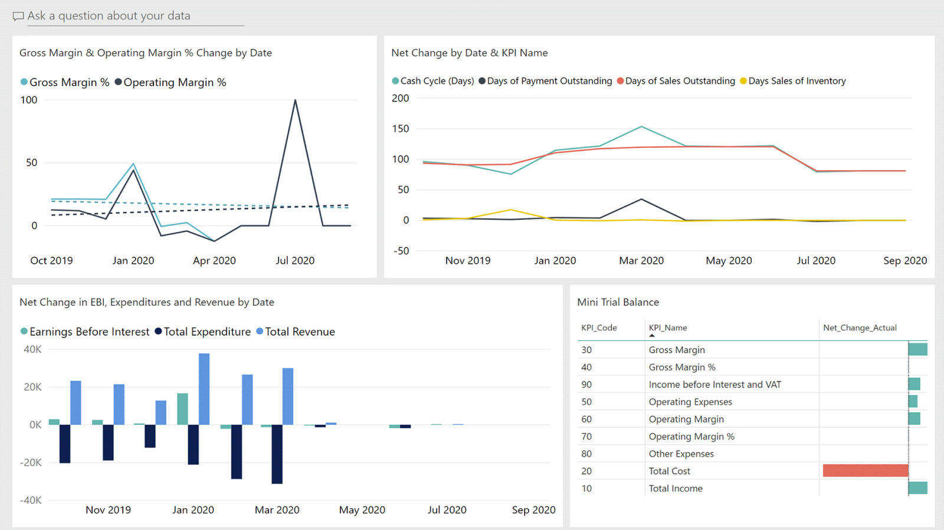
Increase Financial Visibility And Performance
Accelerate financial close, improve forecasting, and get real-time performance metrics while fostering compliance and security across subsidiaries

Slide 6

“ The biggest advantage of business central is the amount of information we can access. We’ve used it to streamline every process, and now any member of our team can utilize and update information in real time.
”
Linda Del Giudice
Sales Executive, Moneysworth & Best Quality Shoe Care

Slide 7
PRODUCT FEATURES
Increase Financial Visibility
And Performance
Accelerate financial
closing and reporting
Monitor financial reporting
Make more profitable
financial decisions
Accelerate financial close, improve forecasting, and get real-time performance metrics while fostering compliance and security across subsidiaries
Expand into
global markets
Finish projects on
time and under budget
Take control of
financial data

Slide 8
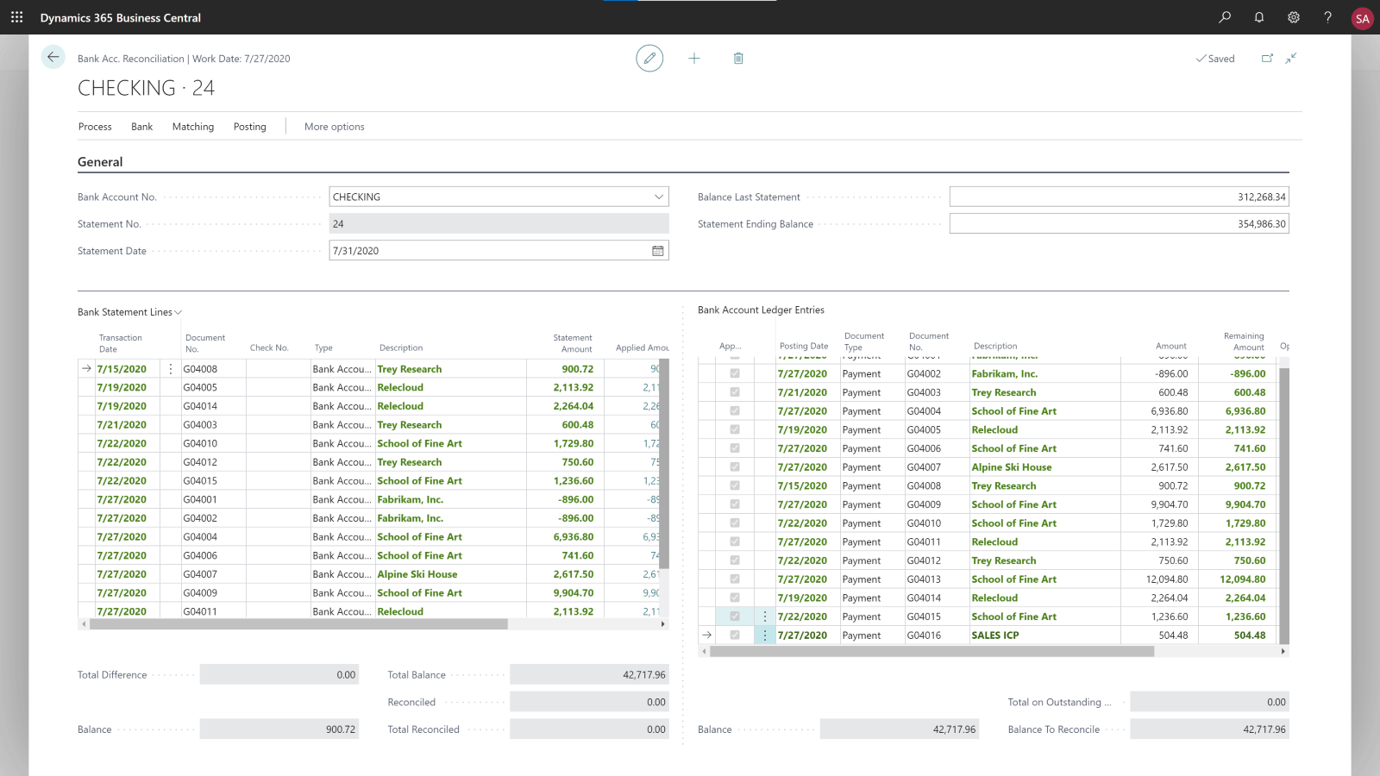
Accelerate Financial
Closing And Reporting
Improve finance department efficiency, profit margin control, and asset ROI, and efficiently manage asset leases.
General ledger
An advanced general ledger structure features unlimited dimensions and dimensional hierarchies, which enable advanced reporting. Set up companies and post to the general ledger though general journals.
Fixed assets
Track fixed assets such as buildings, machinery, and equipment. Post fixed-asset transactions such as acquisitions, depreciation, write-downs, appreciation, and disposal.

Slide 9
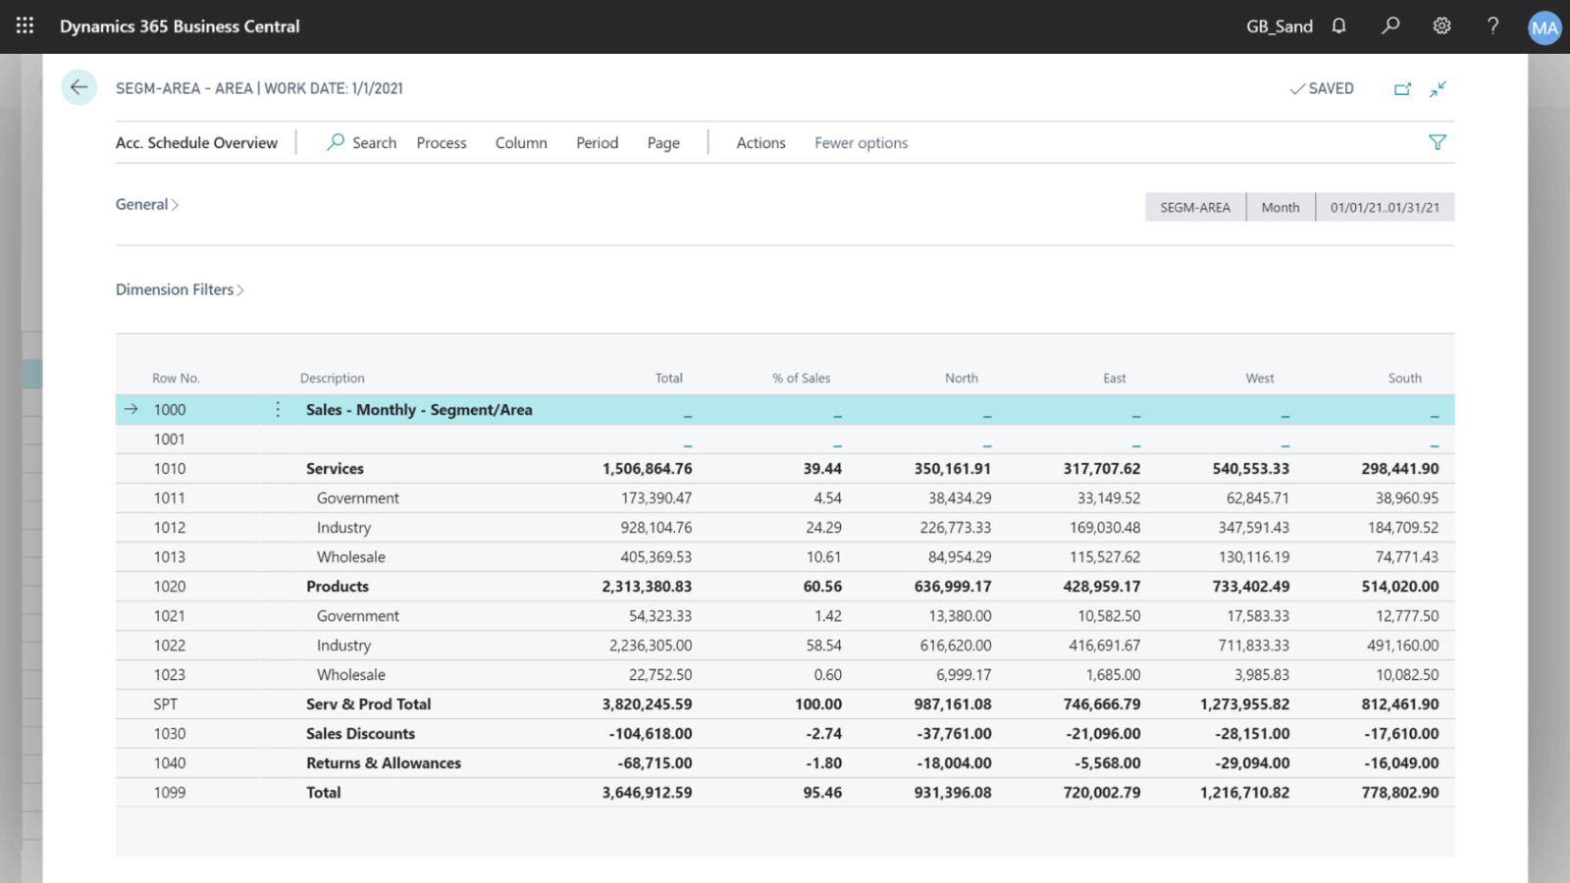
Monitor Financial Performance
Improve profit margin control, cash flow metrics, and finance department efficiency.
General ledger
Use built-in reports, customized reports (both RDCL and Word), and easily refresh data in Microsoft Excel, and Power BI reports and charts.
Cash flow forecast
Predict how your company’s liquidity will evolve over time. Forecast expected cash receipts and disbursements plus available liquid funds.

Slide 10
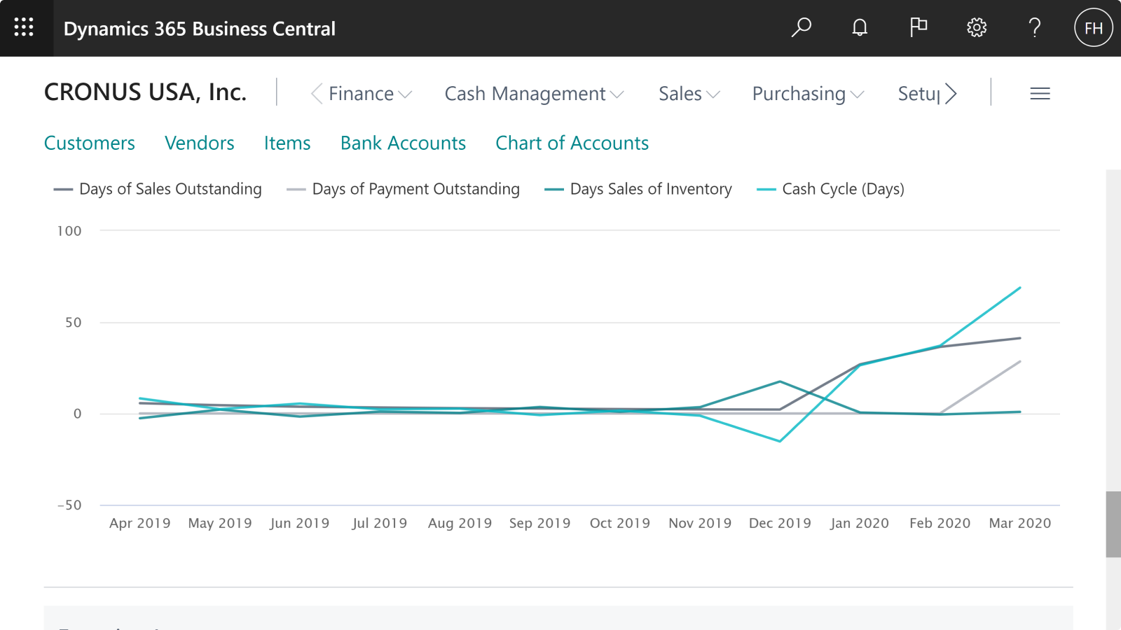
Make More Profitable
Financial Decisions
Improve your profit margin. Get accurate insights. Make financial decisions with confidence.
Reporting and data analysis
Use built-in analytics and reporting that you can use out of the box to help keep track of your business.
Financial reporting (Accounts schedules)
Include essential business data from the chart of accounts, budgets, cash flow accounts and cost types in financial reports. Use the data to efficiently monitor the health of the business and provide valuable input for business decision makers.

Slide 11
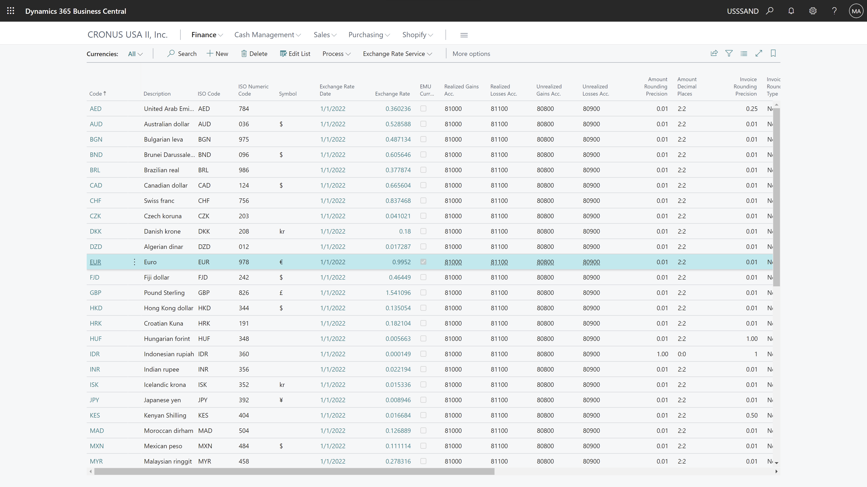
Expand Into Global Markets
Eliminate the need for duplicative software and systems, reduce audit effort, and increase compliance with global regulations.
Multiple currencies
Conduct business with customers and vendors in any number of currencies. Use multiple currencies on sales and purchase documents, bank transactions, and payables and receivables payments.
Consolidation
Consolidate companies from the same Business Central tenant and pull data directly into the consolidation company. Or use XML files to pull data from other Business Central tenants, databases, or third-party business management application.
Intercompany postings
Manage accounting for more than one company in a posting process that includes one or more Business Central tenants or databases.

Slide 12
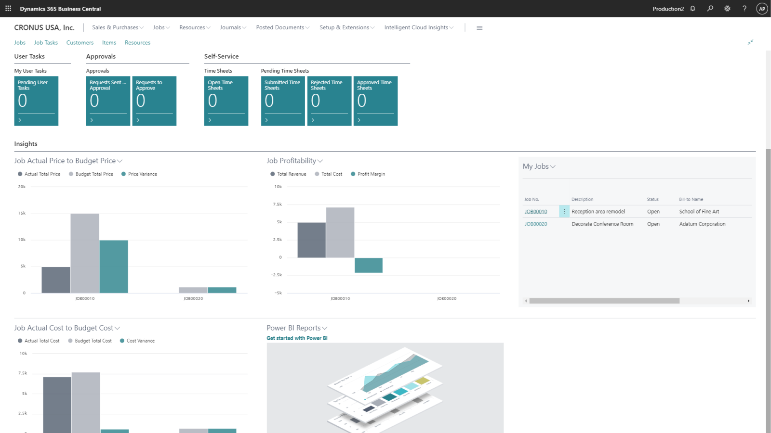
Finish Projects On Time
And Under Budget
Ensure successful project execution and profitability.
Improve efficiency, project insights and asset ROI.
Project costing and accounting
Better manage projects using timesheets and advanced job costing and reporting. Develop and modify detailed budgets to help ensure project profitability.
Multiple costs
Manage alternative costs for resources and resource groups. Costs can be fixed, percentage based, or an additional fixed charge. Define as many work types as you need.
Project insights
Get real-time business intelligence on project status, profitability, and resource utilization metrics.

Slide 13
Take Control Of Financial Data
Improve efficiency and profit margin control. Better understand cash flow metrics. Optimize days sales outstanding.
Late payment–prediction extension
Reduce outstanding receivables and fine-tune your
collections strategy by predicting whether sales
invoices will be paid on time.
Cash flow forecast
Manage and predict cash flow using advanced AI reporting. Predict how your company’s liquidity will evolve over time. Forecast expected cash receipts and disbursements plus available liquid funds.
Bank account reconciliation
Import bank statement data from electronic files sent from your bank. Reconcile bank statement data automatically to open bank account ledger entries and keep track of all bank statements.
Fixed assets
Track fixed assets such as buildings, machinery, and equipment. Post fixed-asset transactions such as acquisitions, depreciation, write-downs, and disposal.
Budgets
Track and report on results against budgets. Use Track to manage budgets across business dimensions.

Slide 14


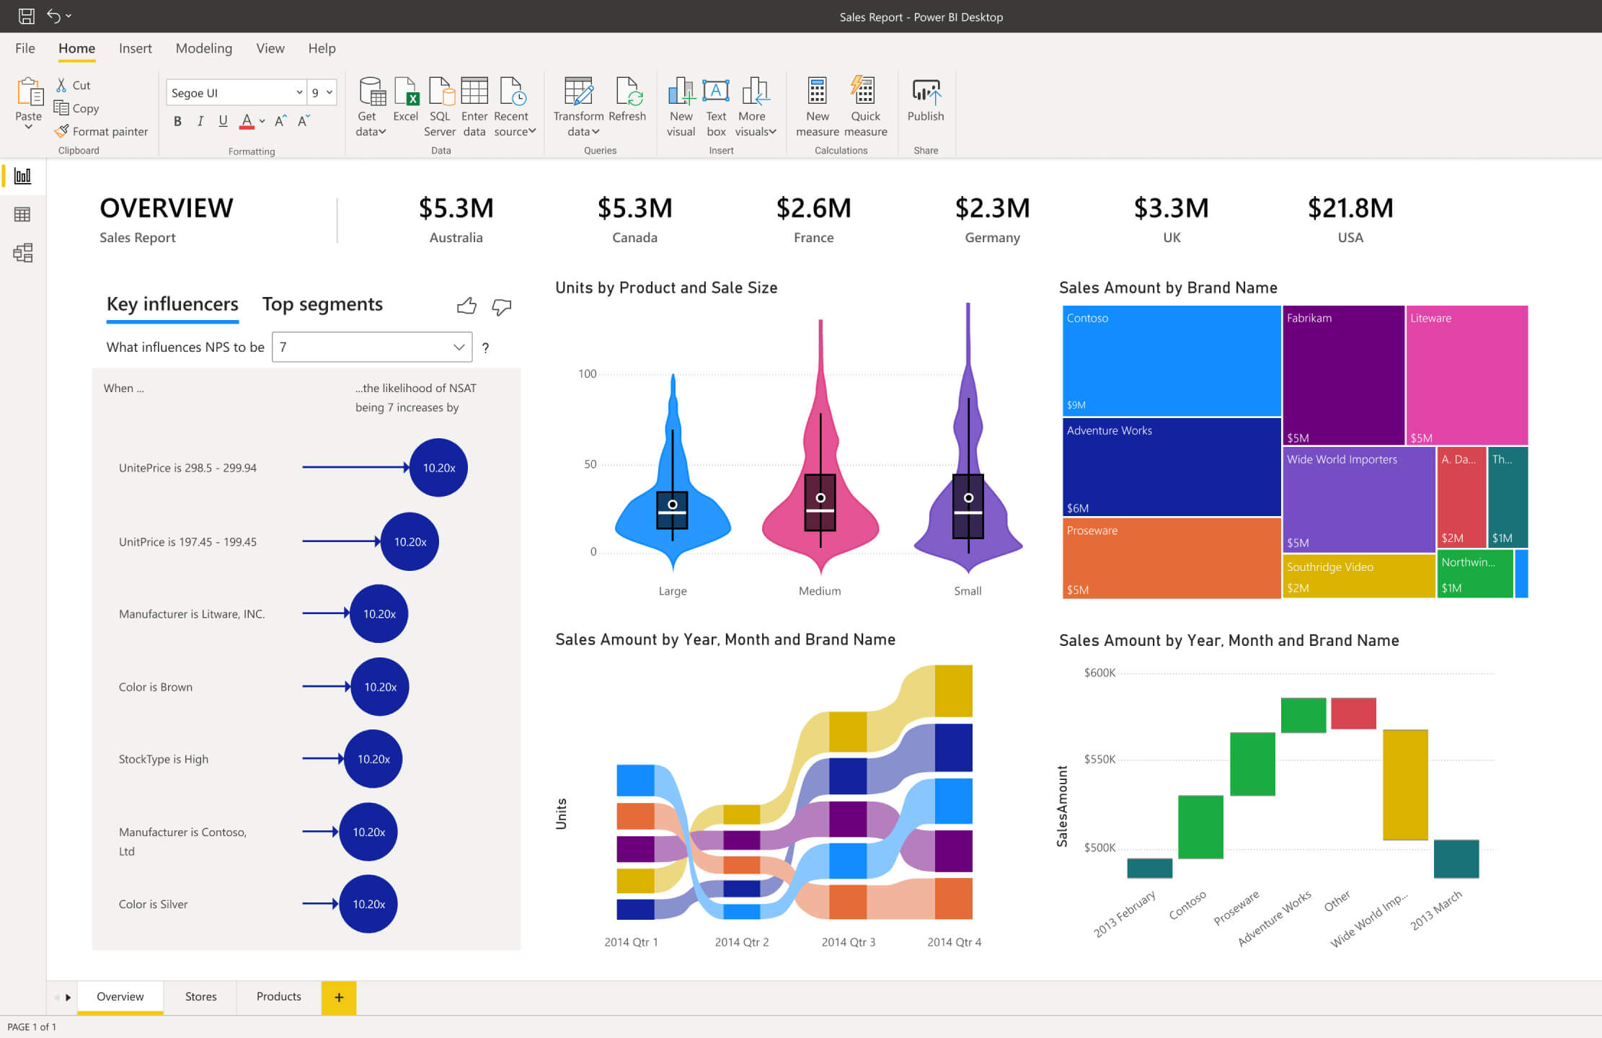


Microsoft Power Platform
Give everyone the ability to create solutions that
accelerate business
Power BI
  Analyze data
        Make informed, confident
        business decisions by putting
        data-driven insights into
        everyone’s hands.
Power Apps
  Build solutions
    Turn ideas into organizational solutions by enabling everyone
    to build custom apps that solve business challenges.
Power Automate
  Automate processes
    Boost business productivity
    to get more done by giving everyone the ability to automate organizational processes.
Power Virtual Agents
  Create virtual agents
    Easily build chatbots to engage conversationally with your customers and employees—
    no coding required.

Slide 15
A Truly Extensible Solution
Rapidly Deploy
And Onboard
Harness Data Everywhere
Modular and
Purpose-built
Reshape And Transform
Deploy solutions and onboard users in days or weeks, not months, to innovate and drive business outcomes in less time.
Connect to hundreds of data sources out-of-the-box, or easily create your own connectors, with seamless Office 365, Azure, LinkedIn, and third-party data sources.
Built using modular, purpose-built applications that integrate with your existing systems and software tools to extend capabilities of solutions you already use.
Work with a trusted Microsoft partner to accelerate success and get the most value from Dynamics 365.

Slide 16
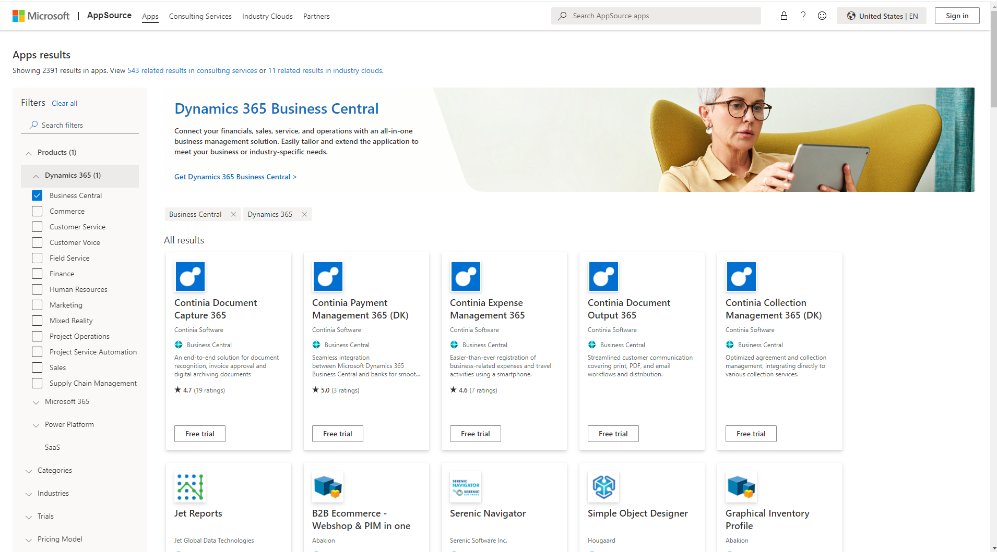
2000+ Apps Designed For
Business Central
Extend the solution to meet you unique vertical or business-specific requirements.

Slide 17

THANK YOU
www.mazayasolutions.com

