Slide 1

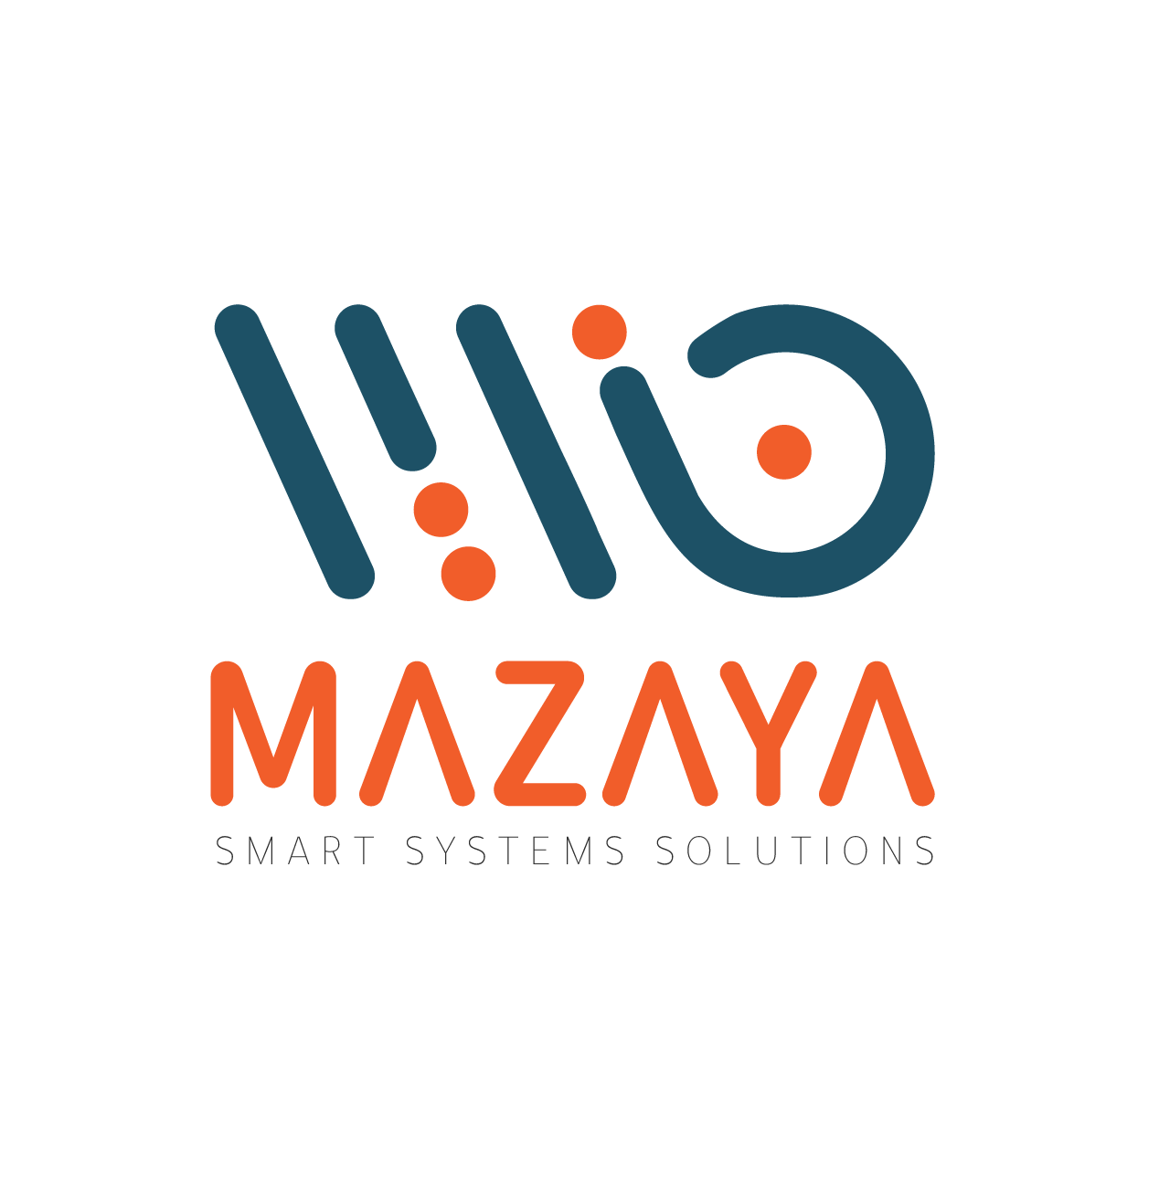
CYBERSECURITY
Zero Trust Security

Slide 2

Mazaya Protects Your Business with Intelligent Cybersecurity
In today's digital world, cybersecurity is critical for safeguarding your company's data and operations. Mazaya provides intelligent, dependable solutions to protect your company from emerging risks and maintain seamless, secure operations. Our services assist decision-makers maintain confident in their decisions.

Slide 3
The Zero Trust Security Model

Slide 4
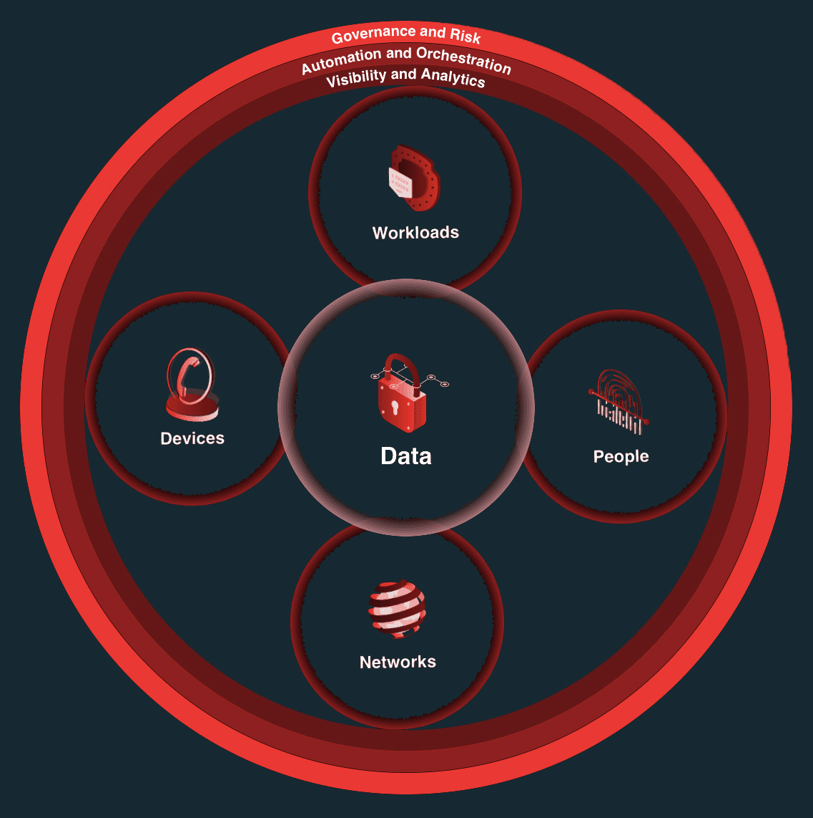
Why Do Organizations Need the Zero Trust Model Today?
In the cloud generation and with rapid digital transformation, traditional perimeter-based security is no longer enough.
Organizations need a more adaptive model one that supports modern infrastructures, mobile users, and cloud environments, while securing data wherever it’s accessed.
Zero Trust aims to eliminate implicit trust and continuously validate every access request.
At Mazaya, we follow Forrester’s Zero Trust framework as the core of our cybersecurity services and strategic offerings.

Slide 5
Solutions we use to protect your business

Slide 6
1) Digital.ai

Slide 7

Digital.ai is a leading technology provider offering smart, integrated solutions across DevOps, DevSecOps, and application security.
Its platform empowers organizations to deliver software faster and more securely by protecting mobile, web, and desktop applications against modern cyber threats.
Digital.ai also streamlines and automates DevOps workflows, enhancing development speed and team efficiency.
Its DevSecOps capabilities ensure that security is embedded throughout every stage of the software development lifecycle.
At Mazaya, we proudly partner with Digital.ai to help our clients achieve secure, agile, and efficient software delivery in today’s rapidly evolving digital landscape.

Slide 8

2) Scanwave System

Slide 9
Scanwave System – Digital Security for Your Business
Scanwave System provides integrated Risk Management (IRM) and consulting services with a strong focus on governance, risk, and compliance.
By aligning cybersecurity strategies with business objectives, it helps organizations remain resilient, compliant, and prepared for evolving digital threats.
Through our partnership with Scanwave, Mazaya delivers these strategic solutions to clients empowering them to manage risk confidently and secure their digital future.

Slide 10
3) Checkmarx

Slide 11

Checkmarx : Unified Application Security (SAST, SCA, DAST, IaC & API Scanning)
At Mazaya, we empower organizations to secure their software development lifecycle through our strategic partnership with Checkmarx, a global leader in Application Security Testing (AST).
We provide a unified approach to application security that covers every layer custom code, open-source components, APIs, and infrastructure.
Leveraging Checkmarx’s advanced capabilities in SAST, SCA, DAST, IaC, and API security, Mazaya ensures our clients are protected from evolving threats while accelerating development.
With deep local expertise and global-grade technology, Mazaya helps businesses in the region build secure, compliant, and resilient applications seamlessly and at scale.

Slide 12

4) ON2IT

Slide 13
Mazaya x ON2IT – Redefining Cybersecurity with Zero Trust Excellence
In partnership with ON2IT, a pioneer in Zero Trust security, Mazaya delivers end-to-end IT solutions designed to elevate operational performance and secure digital environments.
Our offering spans network infrastructure, cybersecurity, cloud services, and IT consulting all tailored to meet the evolving needs of modern enterprises.
By combining ON2IT’s cutting-edge Zero Trust framework with Mazaya’s regional expertise, we help organizations strengthen their security posture, improve scalability, and accelerate digital transformation.
Through proactive management and smart integration, we empower businesses to optimize their IT landscape with confidence and control.

Slide 14
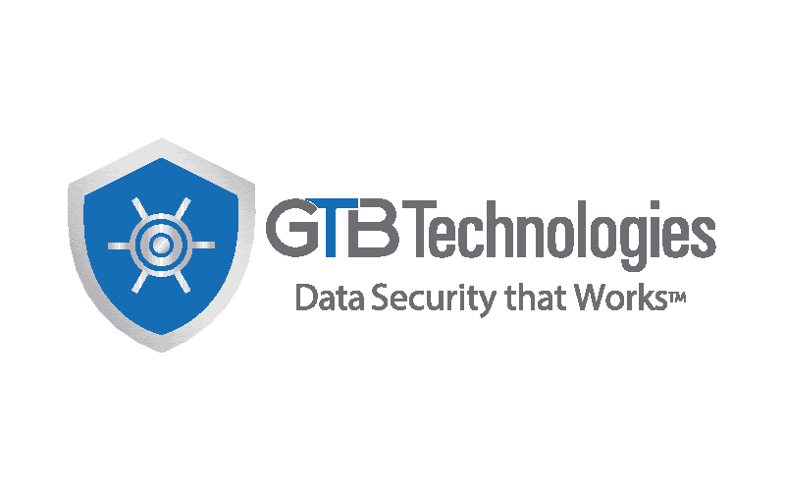
5) GTB Technologies

Slide 15
GTB Technologies: Complete Control Over Your Data Security
GTB Technologies is a global leader in cybersecurity, specializing in advanced data protection solutions that help organizations secure their most sensitive assets across on-premises and cloud environments.
Its platform features powerful Data Discovery and Classification tools that accurately identify and label critical information, laying the foundation for effective data governance. With industry-leading Data Loss Prevention (DLP) capabilities, GTB enables businesses to proactively stop unauthorized data access, sharing, or leakage ensuring compliance and protecting intellectual property.
To further strengthen data security, GTB offers Digital Watermarking that traces sensitive data beyond the enterprise boundary, and Device & Application Control that ensures only authorized endpoints can interact with critical information.
At Mazaya, we partner with GTB Technologies to bring these robust solutions to clients across the region helping them stay compliant, prevent breaches, and maintain full visibility and control over their data in today’s complex digital landscape.

Slide 16
6) Elastic

Slide 17

Elastic: Scalable Search & Cybersecurity Intelligence
Elastic is a robust platform designed to handle big data challenges, offering integrated tools for observability, log management, and search through its high-performance Elasticsearch engine.
In cybersecurity, Elastic provides advanced SIEM and security analytics to detect, investigate, and respond to threats in real time. Its on-premises EDR capabilities safeguard against malware and ransomware, while AI and machine learning enable automated, high-fidelity threat detection and anomaly analysis.
Through our partnership with Elastic, Mazaya helps organizations accelerate insights, secure infrastructure, and modernize their operations with technologies trusted by the Fortune 500.

Slide 18
7) Ridge Security

Slide 19

This system is a comprehensive cloud-native security platform designed to provide continuous protection for cloud workloads and containerized applications. It uses real-time threat detection, behavioral analytics, and automated response to safeguard applications throughout their lifecycle.
By integrating with existing DevOps and cloud environments, it helps organizations reduce security risks while maintaining agility and operational efficiency. For more information.

Slide 20
8) FASOO

Slide 21

FASOO: Discovery, Classification, DRM, Watermarking
Fasoo is a global leader in data-centric security, offering advanced solutions to protect unstructured sensitive data across its entire lifecycle from creation to sharing and storage.
Its platform features intelligent data discovery and classification, automatically tagging and encrypting files to simplify compliance with regulations like GDPR and HIPAA.
Through powerful Digital Rights Management (DRM), Fasoo enforces granular access and usage controls keeping files secure, wherever they go.
With dynamic watermarking and user behavior analytics, organizations gain visibility into data usage and prevent insider threats by tracking and analyzing interactions with protected content.
At Mazaya, we partner with Fasoo to deliver these cutting-edge capabilities to clients across the region helping them achieve full control, compliance, and confidence in managing their most critical information assets.

Slide 22
9) Akamai

Slide 23

This system is a powerful content delivery and cloud security platform designed to accelerate the distribution of digital content to users around the world.
It leverages a vast network of distributed servers to optimize website and application performance by reducing load times and ensuring fast, reliable access.
Additionally, it provides robust protection against cyber threats such as distributed denial-of-service (DDoS) attacks, helping to secure online assets while maintaining a seamless user experience across various devices and locations.

Slide 24
10) Wallarm

Slide 25

This system is an advanced cloud-native web application security platform designed to protect applications and APIs from a wide range of cyber threats. It uses machine learning and behavioral analysis to detect and block attacks such as SQL injection, cross-site scripting (XSS), and API abuse in real-time.
By integrating seamlessly with cloud environments and DevOps workflows, it helps organizations ensure continuous security while maintaining application performance and availability.

Slide 26
At Mazaya, we integrate world-class technologies to drive digital transformation and enhance cybersecurity empowering organizations to stay secure, agile, and future-ready.
Contact us today to discover how Mazaya’s cybersecurity solutions can protect your digital future.

Slide 27

THANK YOU
www.mazayasolutions.com

