Slide 1





Board Management System
Board system makes the work of the Board of Directors and its secretary easier by integrating all essential functions into a single system that saves time and significantly reduces errors and penalties.
Powered by

Slide 2



Invest the time and effort of your Board members
The Board system serves as a platform that facilitates the work of both the Board of Directors and the Board Secretary alike. This application integrates all the board’s essential functions which usually require tremendous effort, long hours, and continuous follow-up from the secretary and members and automates them in line with the regulations of the Capital Markets Authority, the Stock Exchange, and the Central Bank guidelines. This has created a unified system that helps minimize effort, save time, and significantly reduce errors and penalties.

Slide 3





Board Team Values
Flexibility
We view our clients as true partners, working closely together to develop the best solutions. By supporting one another, we invest in each other’s success and growth.
Collaboration
We view our clients as true partners, working closely together to develop the best solutions. By supporting one another, we invest in each other’s success and growth.
Excellence
We are committed to delivering products and services of the highest quality. We continually strive to adopt and apply the latest technologies to better serve our clients. Our ambition is to be recognized as leaders in innovation and application development.
Self-Improvement
We continuously learn, review, and evolve to deliver the best possible experience to our clients. We are not afraid of challenges or mistakes; instead, we see them as opportunities to learn and grow.

Slide 4
Board System Features
Board Members’ Features
1. Board, Committees, and General Assembly Meetings
Accept or decline meeting invitations with the option to provide a reason.
Attend meetings online.
View the meeting agenda.
Access meeting minutes and other related documents.
4. Document Center
Store multiple versions of files.
Track changes made to each version.
Know when each file was uploaded or published on the application.
5. Board and Committee Resolutions
View board and committee resolutions shared by the Board Secretary. Sign resolutions electronically.
2. Calendar
View a dedicated calendar for meetings and tasks.
Synchronize with Google, Apple, and other calendars.
6. Disclosures
Track disclosures sent by the Board Secretary. Sign disclosures directly through the app.
3. Tasks
Track and execute assigned tasks. Create and assign new tasks.
7. Announcements
Follow and view all new announcements through the application.

Slide 5
8. Setting and Tracking KPIs
Ability to set different types of annual Key Performance Indicators.
Update KPIs and perform self-assessments.
9. Induction Program
Review the items required by the Capital Markets Authority for new board members.
Sign off electronically on completion.
10. Corporate Governance
Access and review corporate governance content.
12. Anti-Money Laundering (AML) Courses
Annual AML training has become mandatory for all board members under Kuwaiti regulatory requirements. The application provides online AML courses, where members can watch videos, read materials, take quizzes, sit for the final exam, and obtain a certificate of attendance.
11. Profile Management
Supports different types of board members: Executive Member, Non-Executive Member, Independent Director, Elected or Representative Member, along with their positions.
Ability to update personal profiles, view position details, required training, certifications, and other information.
The system sends monthly reminders to members to review and confirm their updated profiles, helping prevent any compliance issues with regulatory bodies such as the Capital Markets Authority and the Central Bank.
13. Electronic Signature
The application enables board members to electronically sign important and urgent documents, saving both time and effort.

Slide 6
Board System Features
Board Secretary Features
1. Board, Committees, and General Assembly Meetings
  Create and manage different meetings for the board and committees, and track the number and type of meetings required during the year according to the regulations.
  Schedule meetings, display conflicts with other committee meetings, and track acceptance or rejection responses due to timing, as well as attendance status.
  Create the meeting agenda, minutes, internal memos, and other files related to the meeting.
4. Document Center
  Store multiple versions of files.
  Track all changes made to each version.
  Monitor when each document was uploaded or published on the application.
5. Board and Committee Resolutions
  Send board and committee resolutions to members for feedback and signatures.
  Track response rates and completion.
6. Disclosures
  Send different types of disclosures to members and obtain their signatures.
  Generate reports and share them with the Capital Markets Authority.
  Generate official letters and disclosure templates for the Capital Markets Authority.
  Obtain electronic signatures from the CEO or Deputy CEO.
2. Calendar
  View a dedicated calendar for meetings and tasks.
  Synchronize with Google, Apple, and other calendars.
3. Tasks
  Add, track, and execute required tasks.
  Search through all tasks and their details.
  Create a predefined list of recurring tasks at the beginning of the year.

Slide 7
7. Announcements
Ability to add and notify members of new announcements.
8. Setting and Tracking Key Performance Indicators (KPIs)
Ability to set different types of annual KPIs for board members.
12. Reports
Ability to view and export various annual reports/dashboards, including:
  Meeting attendance
  Meeting agenda
  Meeting resolutions
  Company disclosures
  Member disclosures
  Task status
  Quarterly and annual reports
  Committee reports
  Shareholders’ report
9. Induction Program
Establish and review the requirements imposed by the Capital Markets Authority on new board members.
10. Training Programs
Set and monitor the annual training plan for board members, track its status, and upload training certificates.
11. Nomination Process
  Ability to fill out the Capital Markets Authority nomination form for new board members and track applications.
  The application will send a reminder to Compliance if the response from the CMA exceeds two weeks.

Slide 8
13. Corporate Governance
Display corporate governance content.
14. Adding and Updating Members
A section to display all board members with their roles and responsibilities.
Track members with dates and versions.
Ability to add, update, or delete members and generate reports.
17. Technical Features
High-level data security
Cloud hosting
Interface available in Arabic and English
Advanced search
Synchronized calendars
Record of all actions saved
Add tagged keywords
Notification center
General settings
iPad application for members
Support via email, SMS, and notifications
Ability to register and obtain your company’s private server
15. Committees Information and Guidelines
Add committees and set up their information.
Assign members to each committee.
Provide information and guidelines about committees to members.
16. File Templates
Ability to add all official documents to the system, edit them, and use them in other parts of the system.

Slide 9
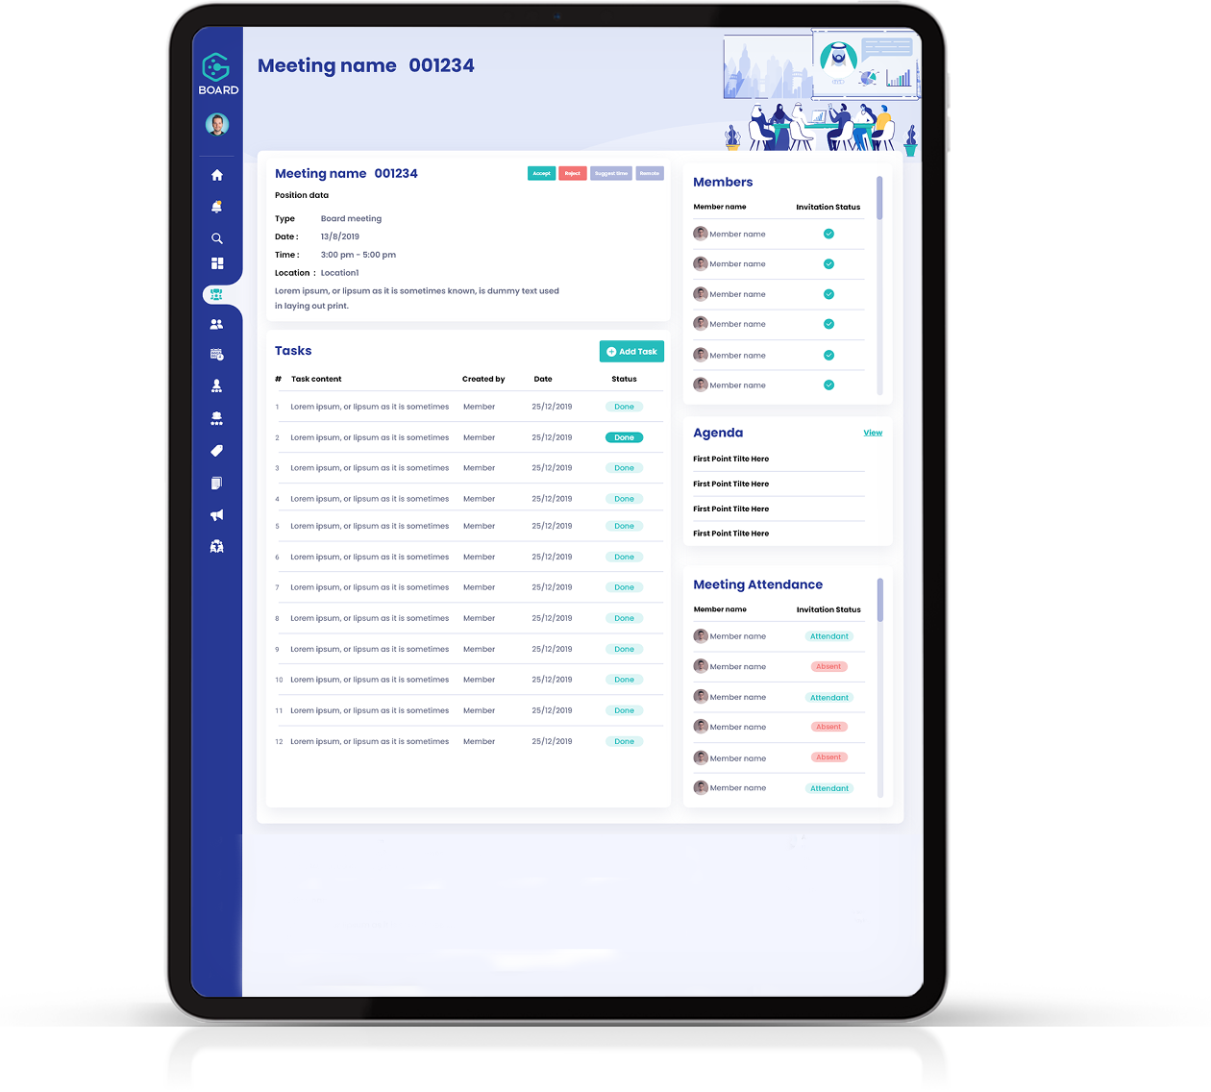
Board Product Updates
1. Board Member Tablet Application
A board member can access Board by downloading the application on their iPad, logging in, and following all meetings, tasks, and more.
2. Online Meetings
The Board application facilitates members’ participation in meetings and enhances communication between participants through modern communication tools.
The Board Secretary can create a meeting and send attendance invitations to members, who in turn can register their attendance online.

Slide 10
1
Future Plan for Board Development
We believe in the importance of continuous development that ensures our systems keep operating efficiently over the years while staying up to date with the latest technologies in the market. For this reason, our dedicated team has already begun working on enhancing the Board application by adding new services and innovating systems that can be integrated to increase its efficiency and comprehensiveness.
Android Tablet Application
A board member can access Board by downloading the application on their Android device, logging in, and following all meetings, tasks, and more.
2
Chat
Every user has the ability to communicate with other application users through the chat feature.

Slide 11

Future Plan for Board Development
Speech-to-Text
Description: Enabling the system to convert members’ inputs during meetings into written text in real time.
2. Added Value:
Automatically simplify the drafting of meeting minutes.
Support members who prefer a written review.
Improve documentation accuracy and reduce manual errors.

Slide 12

Future Plan for Board Development
2. AI-Powered Text Processing
Description: Applying AI algorithms to analyze texts (such as meeting minutes or decisions).
Capabilities:
Summarizing long texts into concise points.
Extracting key decisions or important items.
Classifying topics (financial, administrative, technical, …).
Added Value: Saving time and effort.

Slide 13

Future Plan for Board Development
3. AI Chatbot
Description: Adding a virtual assistant within the system that members can interact with.
Capabilities:
  Answering frequently asked questions about sessions or decisions.
  Fast search within documents or meeting minutes.
  Scheduling meetings or retrieving specific documents.
  Added Value: Enhancing user experience and reducing dependency on support.

Slide 14


Thank You!
www.mazayasolutions.com

